Slide 1
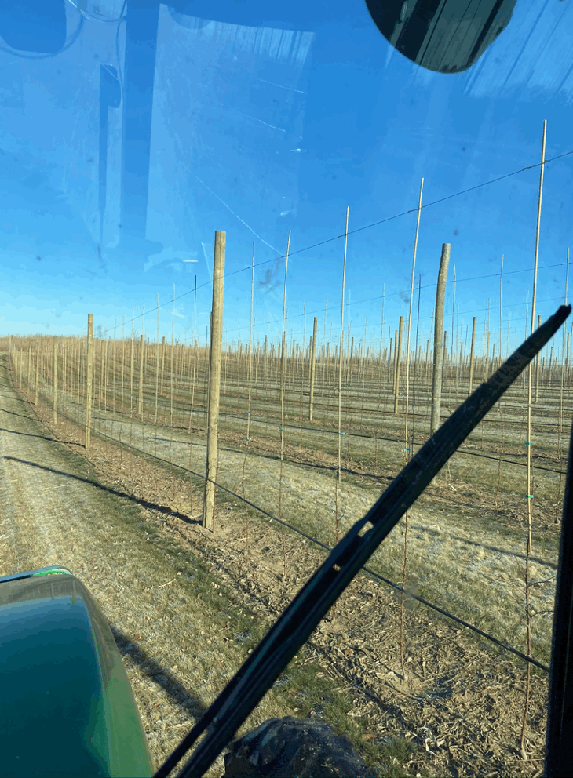
Moving to High Density
What to keep in mind

Slide 2
Main Topics
Reading the Ground
Equipment
Increasing Efficiencies

Slide 3
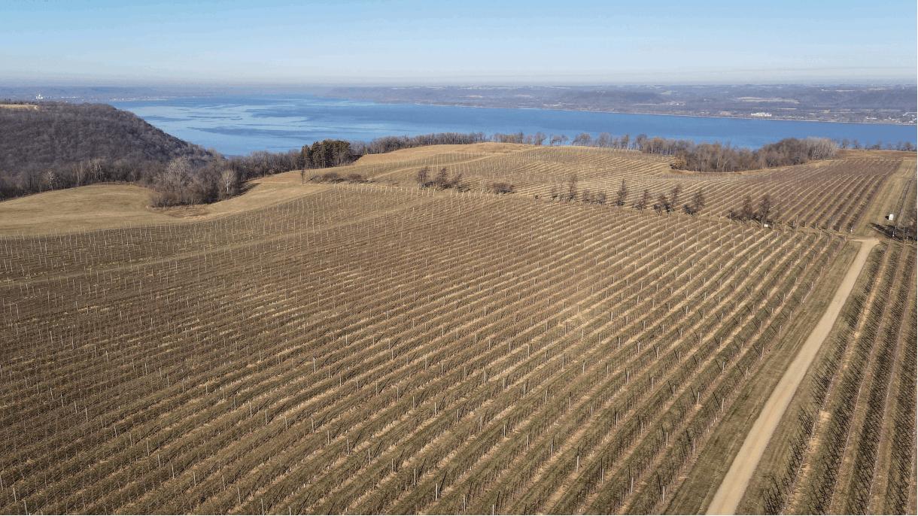
Reading the Ground

Slide 4
Plan your Blocks
Row lengths
Irrigation zone capabilities
Steep terrain
Harvest flow

Slide 5
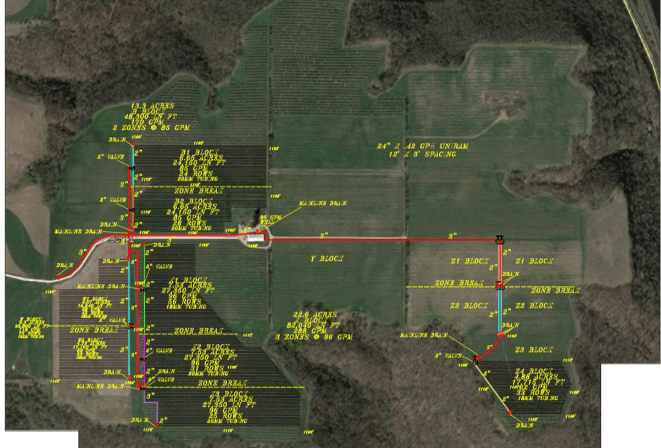
Block layout

Slide 6
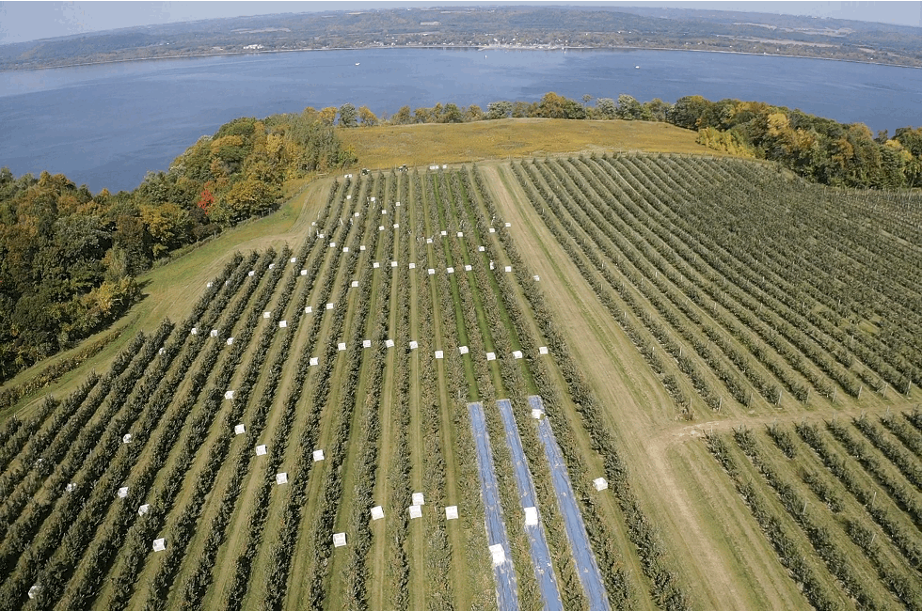
Harvest Flow

Slide 7
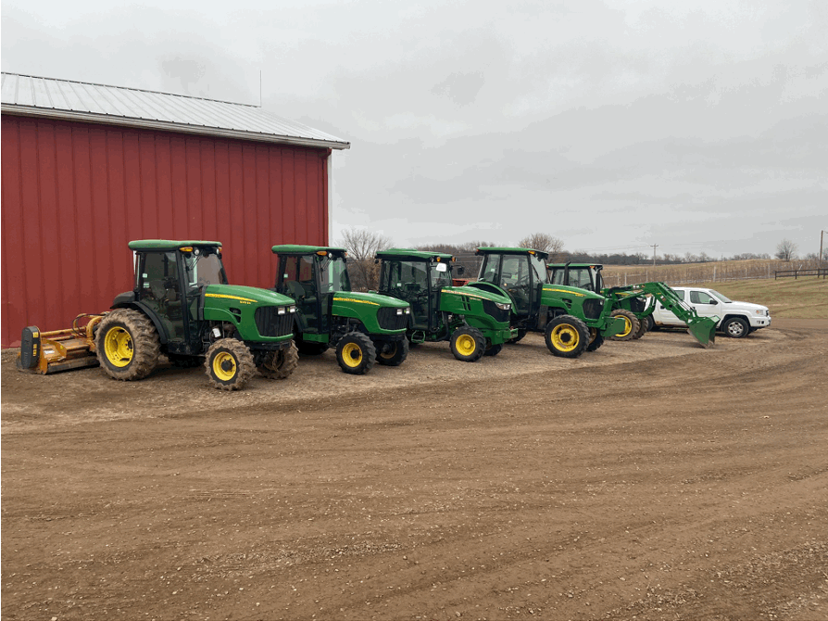
Equipment
“Don’t let your equipment dictate your row spacing”

Slide 8
Narrow equipment can be more expensive
Narrow tractors
Mowers
Sprayers
Harvest equipment
Bin haulers
Platforms
3-point forks
Harvest machines

Slide 9
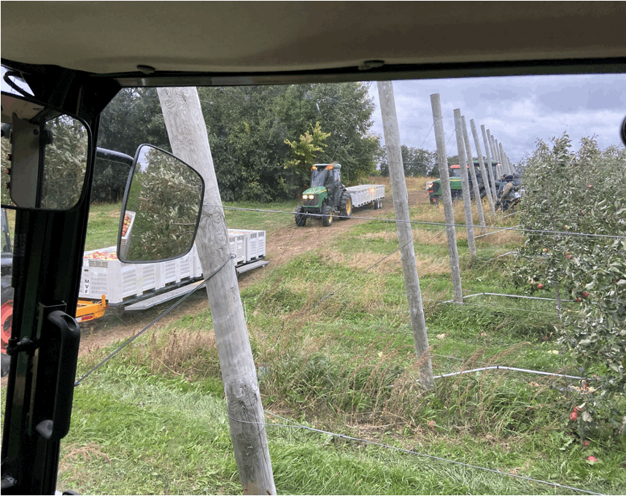
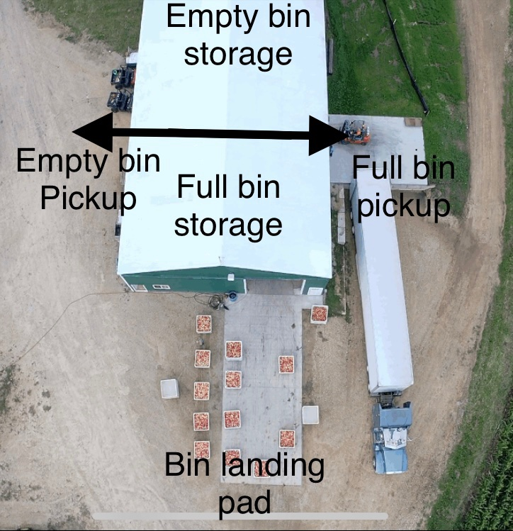
Increasing Efficiencies

Slide 10
Increasing Efficiencies
More fruit quicker
Plan your block moves
Locate and FIX the bottle necks
Have a plan for all the fruit

Slide 11
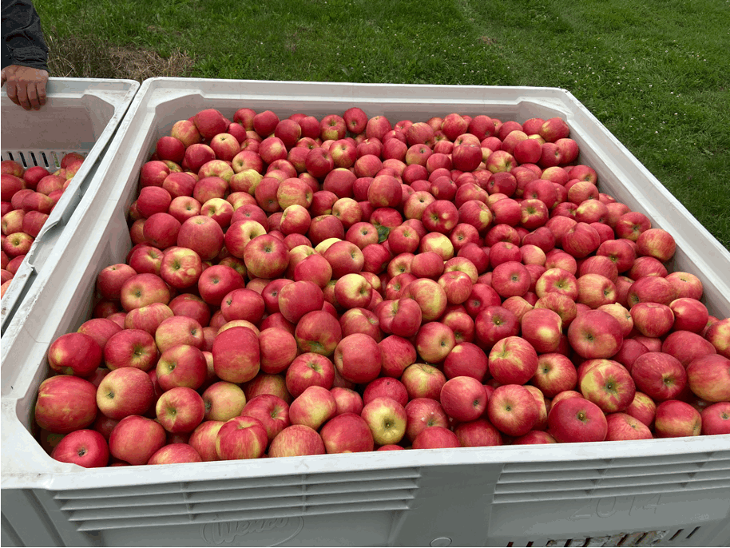
Questions?

