Slide 1
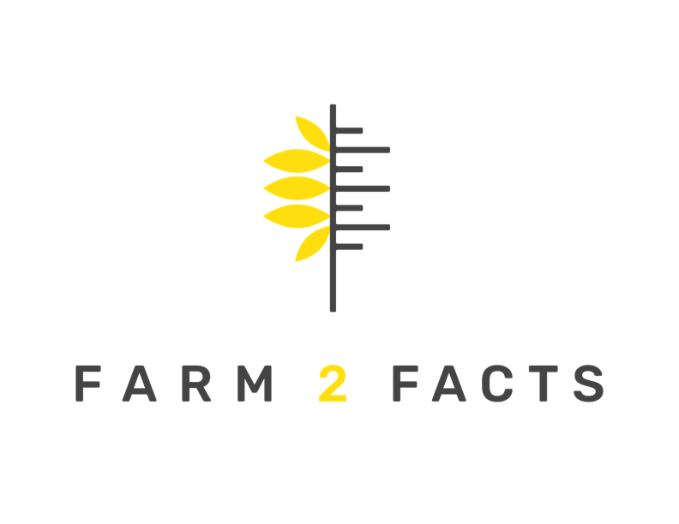
ASSETS AND DATA: GETTING THE MOST FROM YOUR MARKET
Alfonso Morales, PhD
UW-Madison – Department of Planning and Landscape Arch.
Farm2facts.org – Kaufman Lab
WIFMA
January 26, 2020

Slide 2
Who We Are
Lovers of food and agriculture.
Experts in local food systems.
Teachers.
Scientists.

Slide 3
Today’s Objectives
1. Different Perspectives
2. Define Market Assets
3. Examine Company Values
-Determine Your Market’s Values

Slide 4
Process Perspective
--Legal
--Economic
--Policy
--Individual Tastes
--Politics
--Health
Notes:
Like the common good, M are never finished, people’s interests, goals, and tastes change over time, as do relationships, what relationships have you and which would you like?
Problems are possibilities, what are the parts of the situation and how do they produce cooperation/conflict?
Consider the immediate circumstances, but also ask partners to help you think in the long term – what would you like to know, do, or provide, what decisions will there be?

Slide 5
Perspective
Like the common good, markets are never finished.
---People’s interests, goals, and tastes change over time, as do relationships.
What relationships have you and which would you like?
Problems are possibilities, what are the parts of the situation and how do they produce cooperation and or conflict?
Consider the immediate circumstances, but also ask partners to help you think in the long term – what would you like to know, do, or provide, what decisions will there be?

Slide 6
You are the experts and in life you’ve learned from others, likewise your markets, and now hopefully this presentation.
Notes:
Historically marketplaces helped kings and queens achieve distinctions/social status, no such thing as the economy as we think about it today, so markets fostered trade as a political asset, markets were about political status. Today, we have a different situation, a market is a source of community pride, but not just that, markets are multi-faceted assets, community, economic, health, and political.

Slide 7
Assets
What is an asset?
Assets are relationships, produced by interaction, an asset cannot be an asset if it is not valued by someone, people must relate to something to make it an asset.
So, we need to make our markets attractive places for different types of interaction.
Notes:
Legal, policy/political, individual tastes, community, economic, health, are all ways others might think of the market as an asset

Slide 8
Assets Explained: Law
The DCFM is producer only, 200+ vendors, and only WI products.
Q: How did this come to be?
A: Historical changes in tastes and law.
At the DCFM law is an asset. asset, creating the market, relating to the market, and producing relationships at the market. State law helps make that market unique and that law applies to all markets hosted on state property.
Notes:
----Remember this origin story, it’s a way for the market to distinguish itself and serves as an anchor for storytelling. For the DCFM to become an asset people had to have an interest in what it did and the values it expressed.

Slide 9
Asset Examples
--Good Will
--Partner or Umbrella organizations
--Health department
--Library
--Schools
--Civic or religious organizations, etc.
--Vendors, customers, visitors, etc
--Physical locations
--Neighbors of the market
--Friends
How are these all assets?

Slide 10
Market Motivation
What is your markets origin/motivation?
--Is it there to build community?
--To promote economic activity?
--What common purposes does the market help achieve?
--Are there purposes it could help achieve? What are those?
--How has the market changed over time? In terms of who shops? Local regulation? Conflict / cooperation with others?
What values do those common purposes express?
Notes:
Inclusivity? well-being of some kinds? Integrity, product quality?

Slide 11
Company Values
Barnes & Noble
--Customer Service, quality, empathy, respect, integrity, responsibility, teamwork
Ben & Jerry’s
-- Dedicated to minimizing negative impact on environment, involved in and care about community, support nonviolent ways to achieve peace and justice, support sustainable and safe methods of food production that reduce environmental degradation, etc
Build-A-Bear
--Reach, learn, di-bear-city, colla-bear-ate, give, cele-bear-ate

Slide 12
Introspection
Who are you an asset for?
Local business, city government, farmers, consumers, old folks, folks with families, food insecure folks, musicians/entertainers, schools, government offices? Who would you like to think of you as an asset?
What are your market’s values?

Slide 13
Markets as an Idea
Markets can express many goals and values.
--Local foods and farmers – how to support them? (co-)Sponsor farmer circles (with extension/others)?
--Ecologically important
--Supporting food security – Example of Brown Deer WI
Notes:
After the introduction of Chloe Green’s WIF program, Brown Deer increased its SNAP sales from $512 to $4,397.75 (more in Discussion).
Very little SNAP redemption in BD, MMM program, viola,

Slide 14
Markets as an Idea
Markets can express many goals and values.
--Religion and Politics
--Entertaining and popular places
--Community gathering/unity/information and resilience/spirit
Example of the Oneida
--Supporting, promoting and providing health and prosperity
Example of the Fondy Market Veggie prescription program
Notes:
https://www.learngrowconnect.org/fvc
What is health and for who?
Fondy Currently, clinics fund the number of prescriptions that they choose to distribute plus a 20% printing and processing charge for Fondy to have the prescriptions made
o Forexample,100prescriptionswouldcost$4,800 ▪ 100 prescriptions x $40 each = $4,000 ▪ 20% of $4,000 = $800 for printing and processing of prescriptions

Slide 15
Markets as an Idea
Markets can express many goals and values.
--Economic contribution
-Kitchen incubators, inclusive ethnically and otherwise
-Arts/crafts
-Business (immigrant and other)
-Positive relationship to local businesses
Notes:
Brown Deer generated over $35,000 of impact, when classified into a mid-sized or peri-urban county. South Milwaukee and Downtown Appleton, both urban areas, generated over $107,000 and $899,000, respectively. The only rural market of the four, Sheboygan, generated an impact of over $73,000.
. Fond du Lac Farmers Market’s economic impact was estimated to be $1.1 million, given the total market sales in addition to neighboring spending data. Without the additional metric which would allow estimation of neighboring commerce, F2F would have only estimated $488,877.

Slide 16
Conclusion
Markets are never finished, and assets are not things.
Both markets and assets are interactions over time where people/organizations in their activities/processes are relating their values to your activities.
Markets express many goals and values – and you want to celebrate these, report these, build on these!
Notes:
Conclusions: We are not blind and markets are not the proverbial ‘elephant’ that we touch and think it a wall or hose or rope. But we do have to show others what we know. We have to explain how we know, we have to interpret for folks the processes we help oversee, and we have to decide what it is we can try to improve, with who, and to what effect. Initiative and resourcefulness, relationships, thinking in terms of interaction, pausing to evaluate and experiment. thanks, book give away, UIowa press! ☺

Slide 17
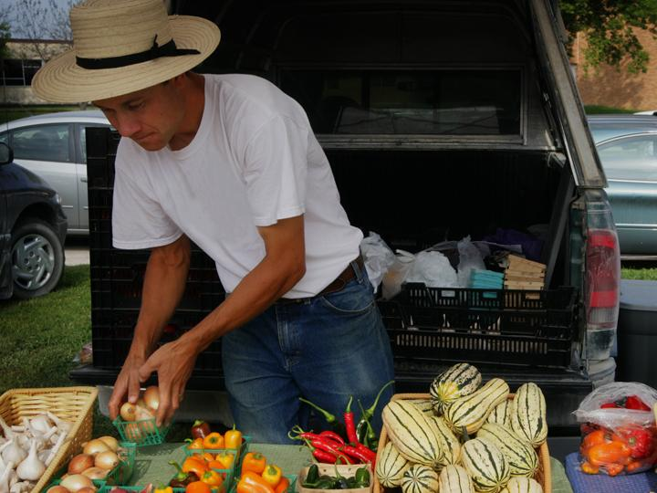
Questions?
Thank you for having us.

