Slide 1
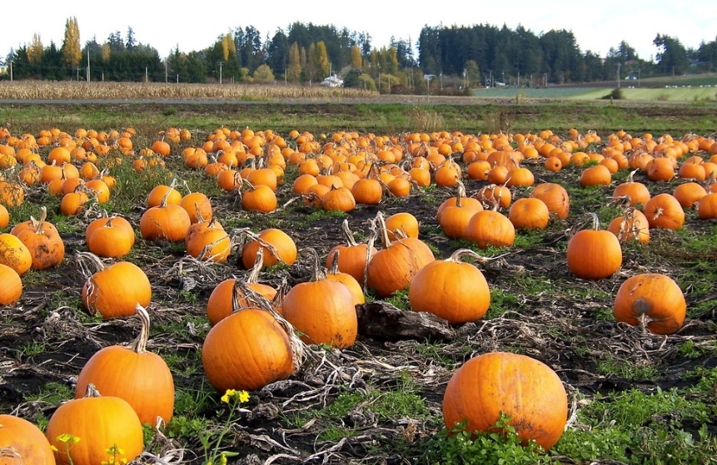
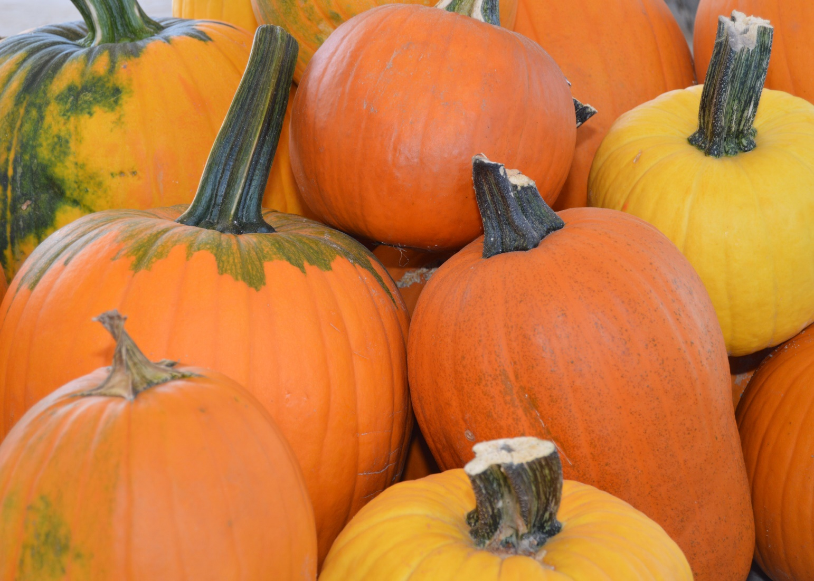
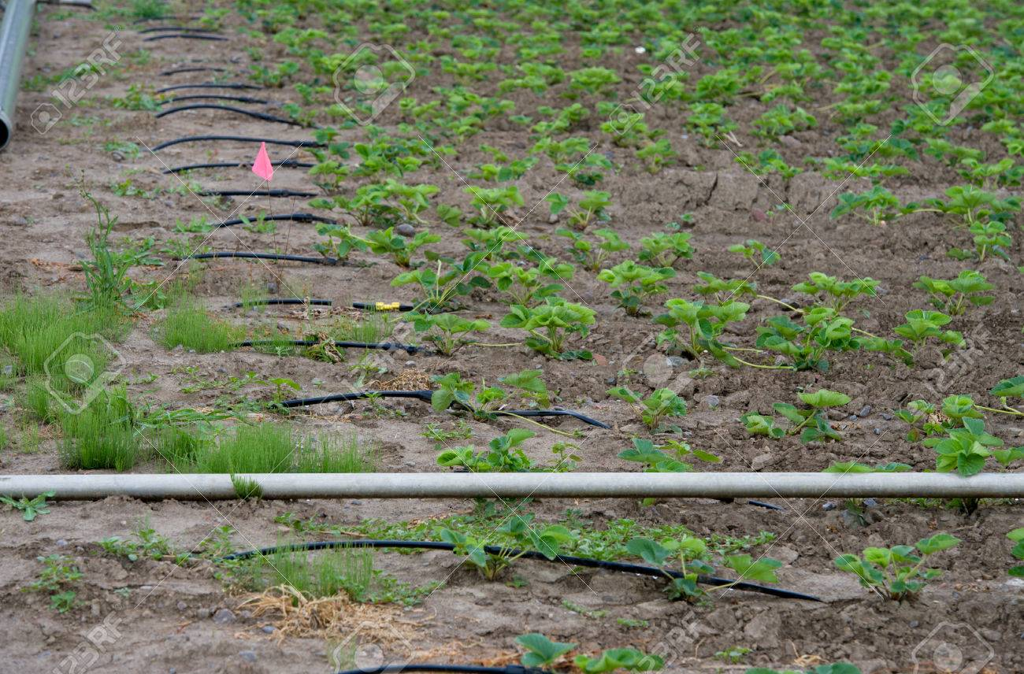
Irrigation management in Pumpkins
Yi Wang
Assistant Professor, Sustainable Vegetable Production
Department of Horticulture
University of Wisconsin – Madison

Slide 2
Pumpkin irrigation
Pumpkins are big water users
Proper irrigation is critical for pumpkin production
Optimal irrigation management produces large, healthy plants, and maximum yield and superior quality of pumpkin fruits
Under-irrigation causes yield reduction, increased blossom end rot, and irregularly shaped pumpkin
Over-irrigation increases disease susceptibility, particularly powdery mildew, causes more fruit rots, lowers water use efficiency, and leads to nutrient leaching – ongoing water quality issue

Slide 3
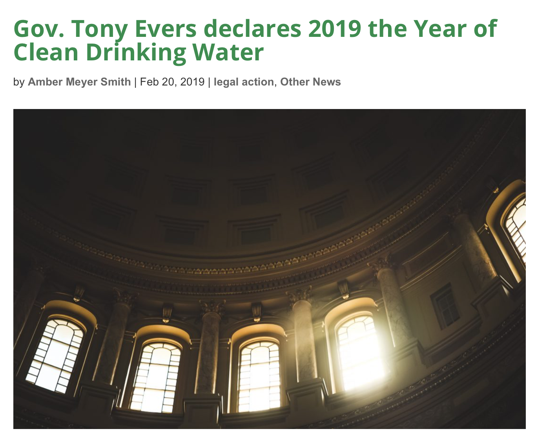
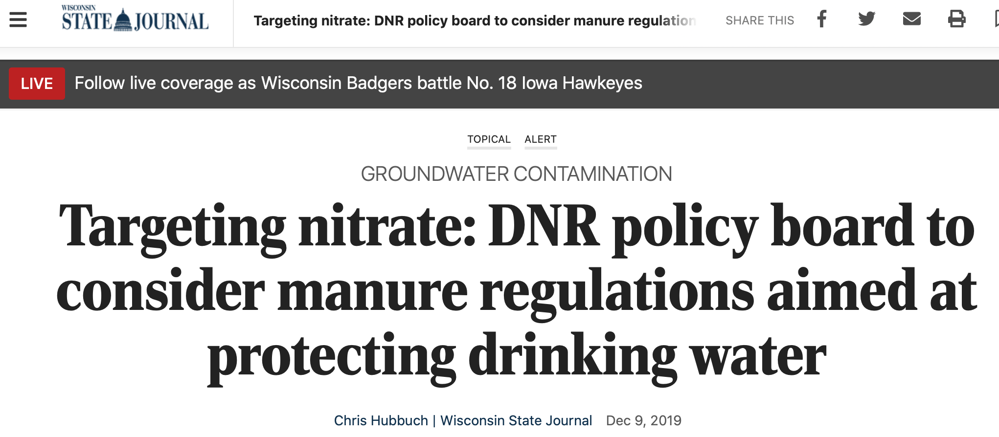
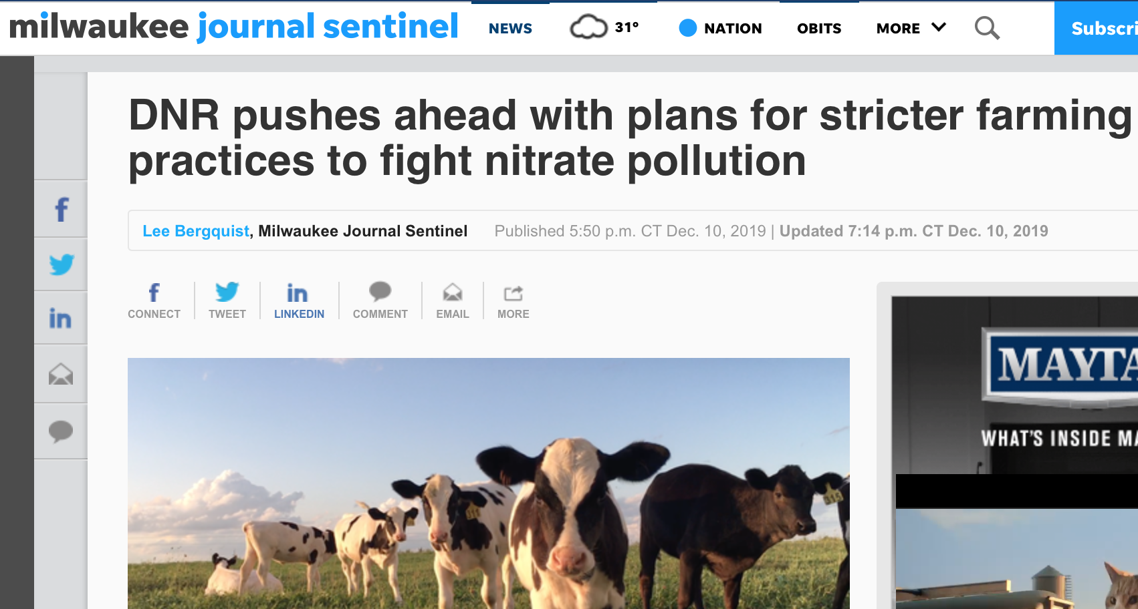

Slide 4
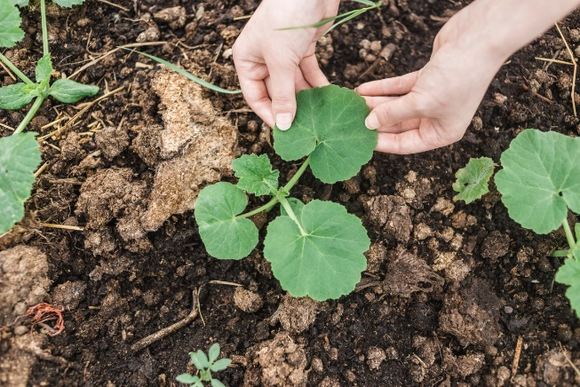
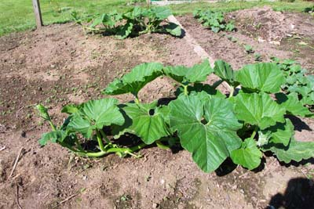
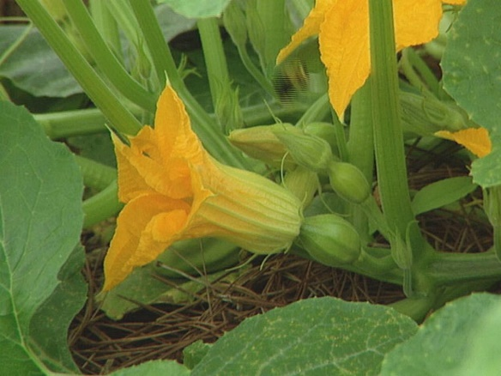
Pumpkin irrigation
Proper irrigation is critical at different growing stages of pumpkins
seedling emergence – poor and uneven emergence
vine extension – limited leaf area development, slowed down photosynthesis, and reduced productivity
blooming and fruit sizing – flower abortion and less-than-full-size fruit
Water stressed plants are more susceptible to insect attack

Slide 5
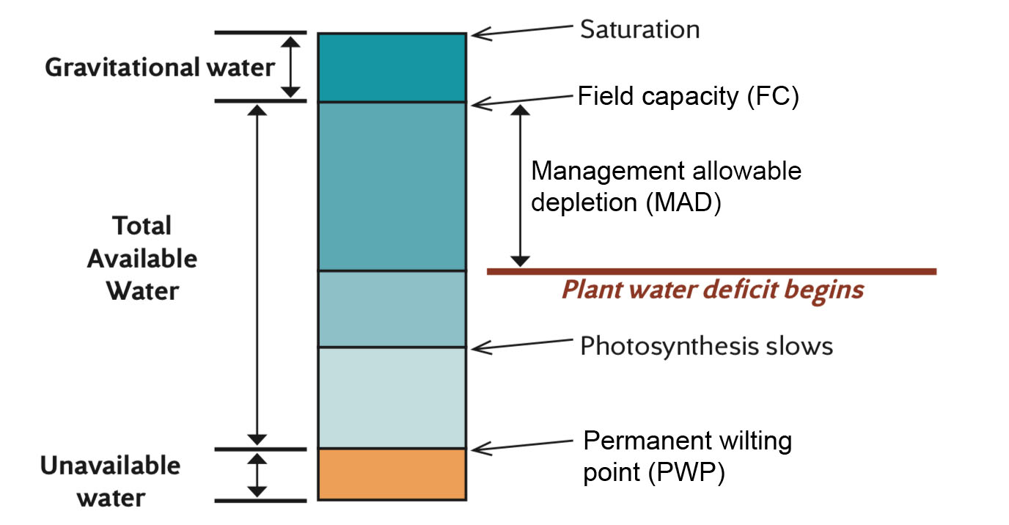
Irrigation science 101
Wet
Dry
Field capacity (FC): maximum amount of water that a soil can hold against gravity (% of volume)
Management allowable depletion (MAD): the lowest moisture level that can be sustained by plants without adverse stress effects. The amount of MAD for pumpkins is about 50% of the total available water in the soil
Permanent wilting point (PWP): the amount of water in a soil that most plants growing in that soil can no longer extract water

Slide 6
Soil water content for pumpkins
The goal of a well-managed irrigation program is to maintain soil water content between field capacity (FC) and management allowable depletion (MAD)
In other words, make sure that plants do not experience water stress or excessive soil moisture, and there is always readily available water in the soil

Slide 7
Soil water content for pumpkins
The amount of readily available water in the soil is related to
the effective rooting depth of the plants – depends on soil condition and variety, typically the top 2 feet of soil
the water holding capacity of the soil – coarser soils (sandy) hold less water than fine textured soils (silts and clays)

Slide 8
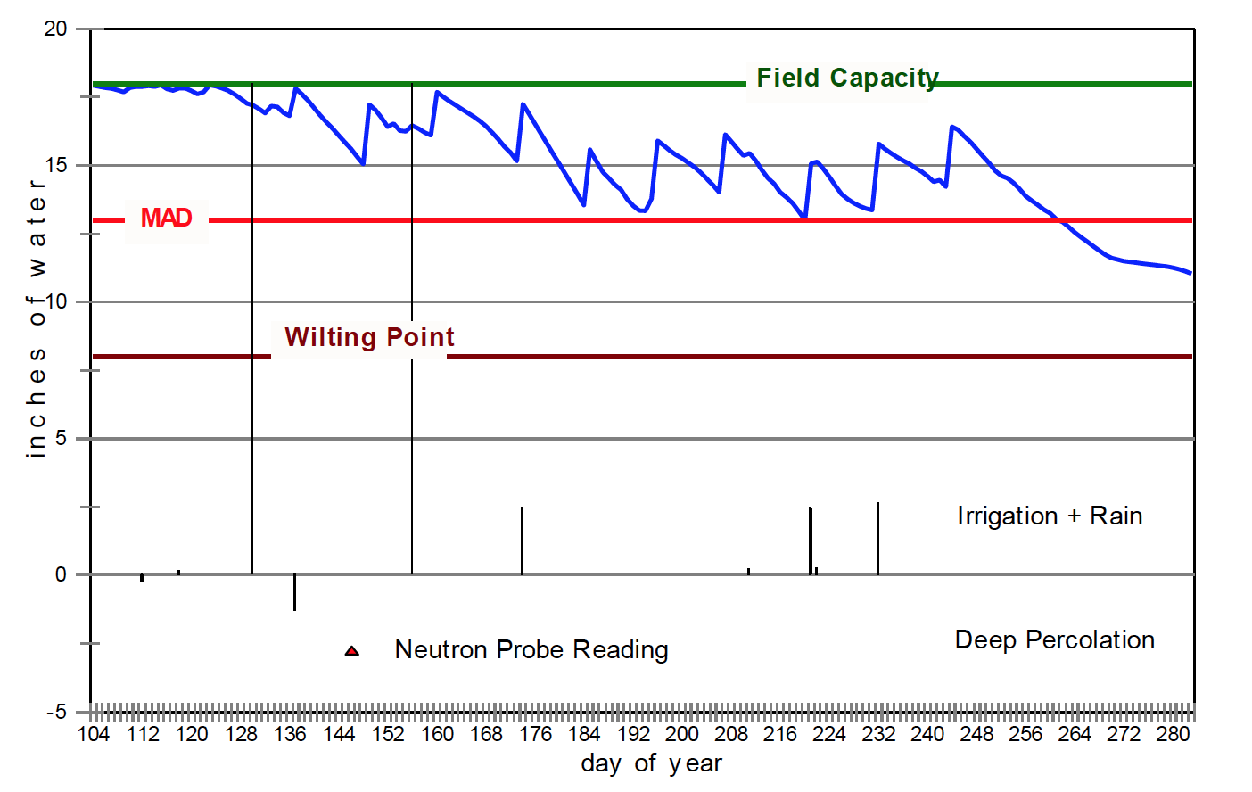
Good irrigation management
Graph courtesy of T. Peters

Slide 9
Readily available water in the soil for pumpkins
Soil texture | Management allowable depletion (inches in top 2 feet of soil) | Total available water (inches in top 2 feet of soil)
Sands and fine sands | 0.5-0.75 | 1.0-1.5
Loamy sand | 0.8-1.0 | 1.6-2.0
Sandy loam | 1.2-1.5 | 2.4-3.0
Loam | 1.8-2.0 | 3.8-4.0
Silt loam, silt | 2.0 | 4.0
Silty clay loam | 1.8-2.0 | 3.8-4.0
Sandy clay loam, clay loam | 1.7-2.0 | 3.4-4.0
Source from University of Utah

Slide 10
How to measure soil water content for pumpkins?
In order to measure soil water content, soil moisture probes can be installed at different soil depths
In the primary rooting zone (top 12 inches)
Near the bottom of where the thickly branched lateral roots grow (18-24 inches)
One of the most cost effective and reliable soil moisture probes is the WatermarkTM sensor – about $50 per sensor

Slide 11
How to measure soil water content for pumpkins?
WatermarkTM sensor
Measures the soil water tension – how easy plants can extract water from the soil
There is a negative relationship between soil water tension and available soil water content
Sensors can be permanently installed in the soil, wires from the sensors are attached to a handheld unit that shows readings

Slide 12
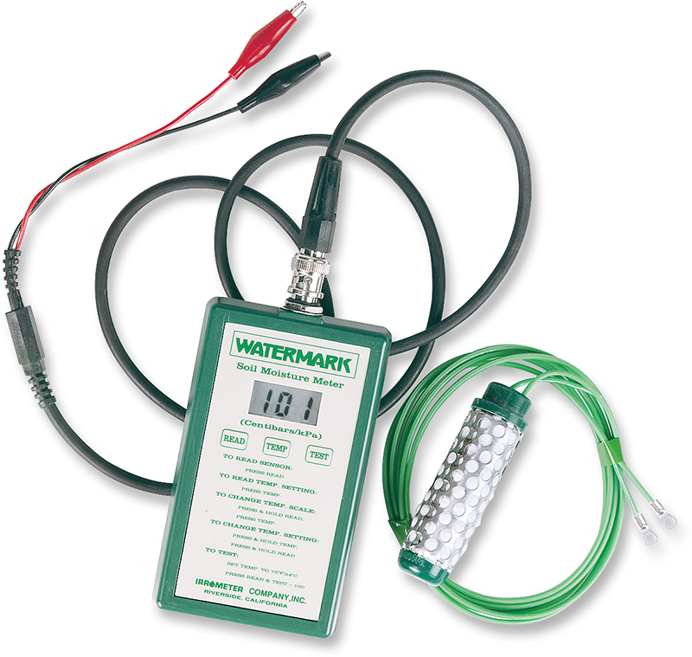
WaterMark Sensor
Sensor | Advantage | Disadvantage
WaterMark Sensor | Can measure a large area (8-inch diameter) Inexpensive If soil does not dry out, little maintenance is required | Relatively inaccurate Performs poorly in sandy soils due to slow reaction time Susceptible to drying; must be dug out and reset when this occurs

Slide 13
Soil moisture sensor for pumpkin production
Readings of the Watermark sensor range from 0 to 200 (centibars)
Sensor readings at which to start irrigation differ between soil types
Soil type | Irrigation started at (centibars)
Loamy sand | 40-50
Sandy loam | 50-70
Loam | 60-90
Silt loam, silt | 70-90
Clay loam or clay | 90-120

Slide 14
Pumpkin irrigation
Pumpkins need at least one inch of water every week, particularly during bloom and fruit development
As plants grow, notice if leaves wilt in the middle of the day. If so, they need water
Sprinkler and drip irrigation are commonly used to irrigate pumpkins

Slide 15
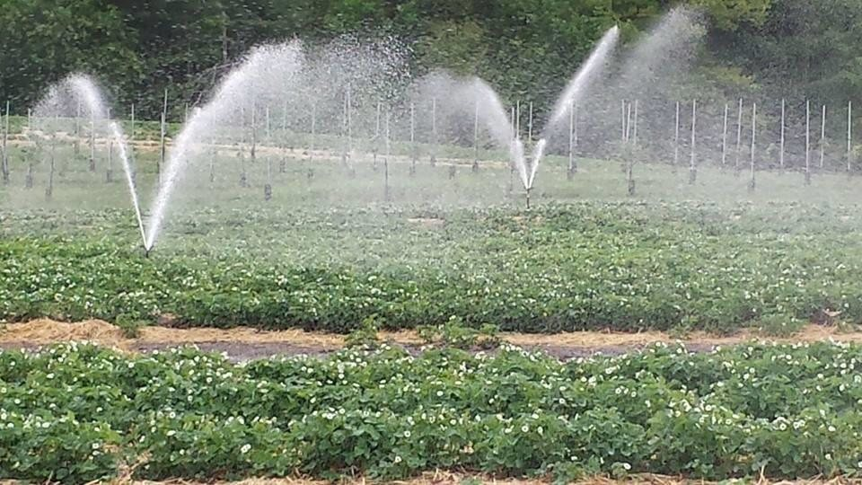
Irrigation systems for pumpkins
Sprinkler irrigation can be effective
Solid set and traveler hose wheel
Irrigation efficiency typically 60 – 75%
When irrigating vine crops, even a few hours of crown wetness can damage the root system
Therefore it is important to keep water away from the crown of the plant
Downside of sprinkler irrigation
May lead to increased disease problems due to moisture on the foliage
Also may increase weed pressure

Slide 16
Downside of sprinkler irrigation
Pumpkins are monoecious plants and most of them depend on pollinators for fruit set
Pumpkin fields are generally pollination deficient
Pollinator limitation
Suboptimal flower sex ratio
Exploitative competition between invasive ants and bees
Sprinkler irrigation fills water in flowers
Bees visited water-filled flowers, but, did not land
Water-held flowers set no fruits
Sprinkler irrigation, despite covers a large area effectively, may not be an appropriate irrigation method for pumpkin during flowering period

Slide 17
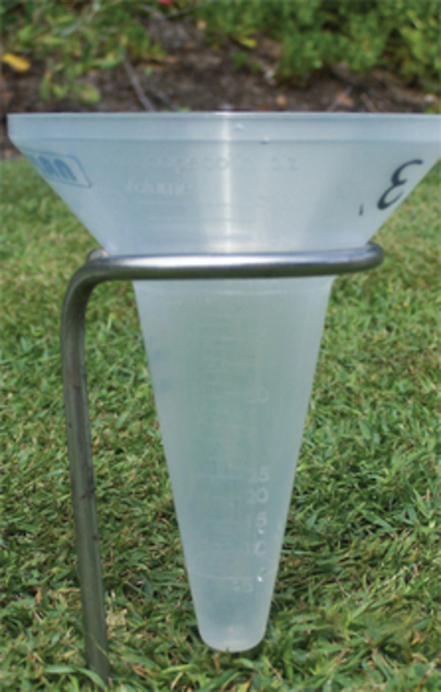
Check the application uniformity
The purpose is to know precisely how much water is being applied – application rate (inches per hour)
Place catch cans in different spots within the field and collect water for a set period of time
Place at both ends of the system
If there is a slope, place at the highest and lowest points
Differences in water collected among the catch cans can tell you how uniform the application is

Slide 18
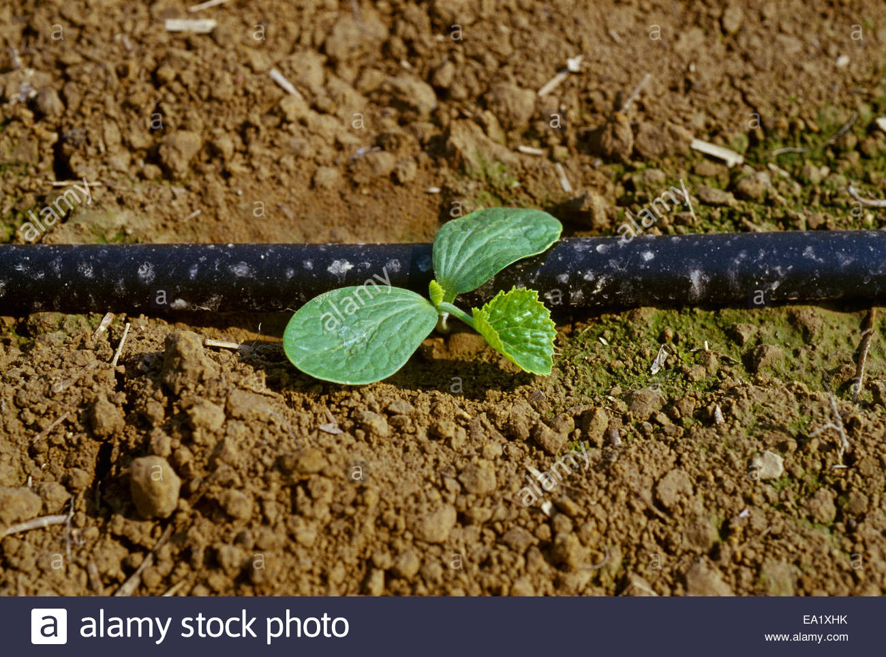
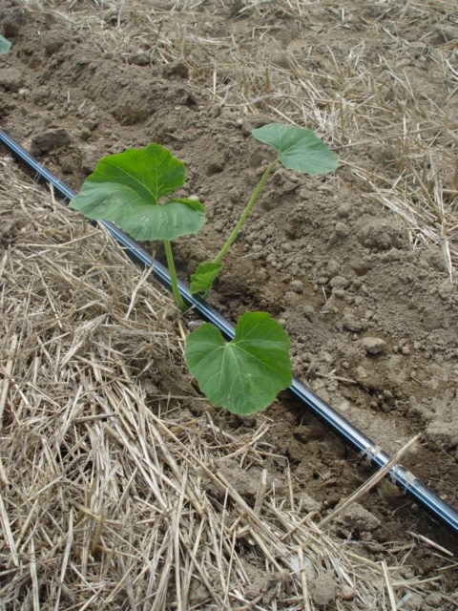
Irrigation systems for pumpkins
Drip irrigation works the best to supply adequate moisture to pumpkins without wetting the foliage
Irrigation efficiency usually 80 – 90%
It is a much more water efficient system
Better fertilizer management
Reduced water use
Improved pest and weed control
Increased marketable yield
However, cost relative to crop value may be hard to justify in all cases

Slide 19
Drip irrigation system for pumpkins
Most drip tapes operate at 10 – 20 psi depending on field condition
Emitters may be spaced from 4 to 36 inches apart and come in a variety of flow rates
Pressure compensating emitters (PC) provides the best application uniformity
Drip irrigation systems are usually operated every day or every few days to maintain optimal soil moisture

Slide 20
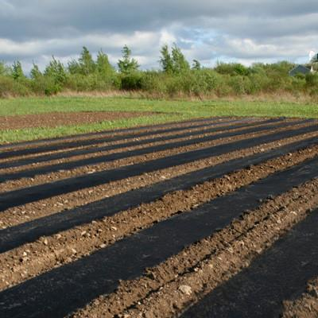
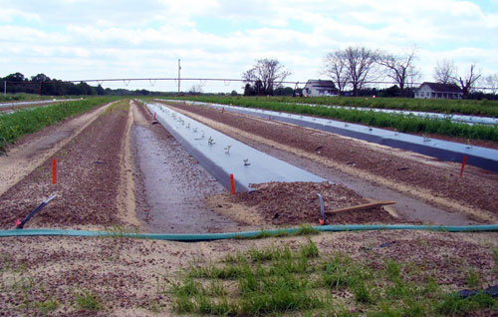
Drip irrigation + plastic mulch for pumpkins
Drip irrigation works particularly well with black plastic mulch that can help keep moisture in the soil
Besides, plastic mulch raises the soil temperature in the early season, so you can add 1-3 weeks to the growing season
Plastic mulch also keeps pest and weed pressure down

Slide 21
Source from University of Tennessee

Slide 22
Summary
Good irrigation management of pumpkin requires
An understanding of the soil-plant-water relationship
A properly designed and maintained irrigation system, and a knowledge of the system uniformity and efficiency
Proper irrigation management based on:
Soil type
Weather and its effects on crop demand
Stage of crop growth
Each component requires a commitment to proper management that can result in maximal yield per applied irrigation water (water productivity), and will optimize the long-term health and productivity of your pumpkin crop

