Slide 1
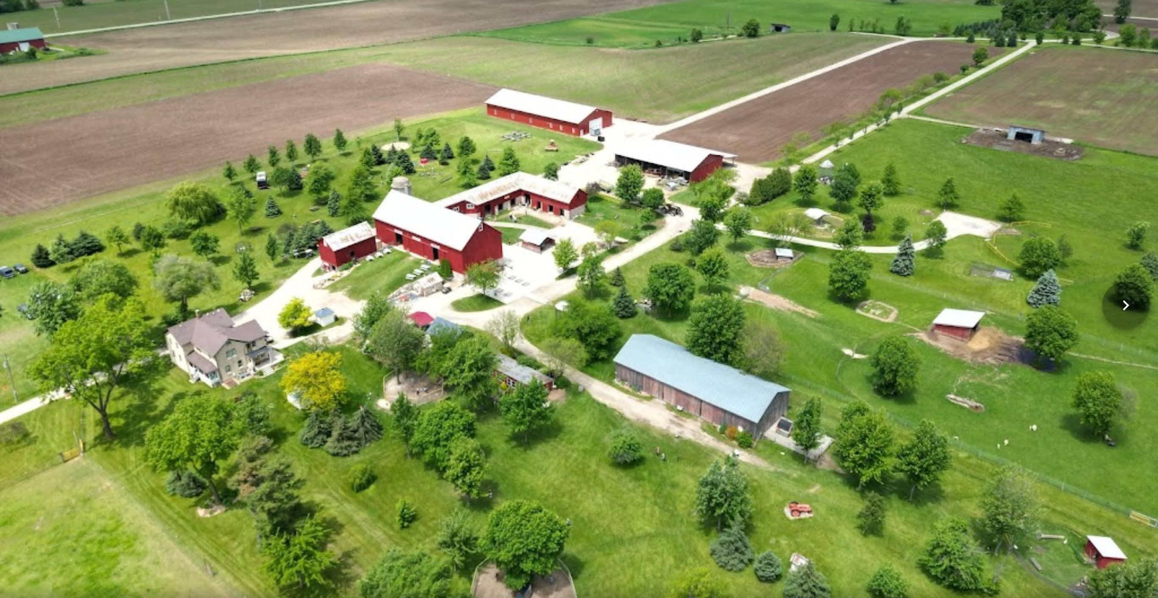
VISA Worker Program - H-2A - U4U
Bonnie Keyes, Mulberry Lane Farm
Notes:
We are located in Hilbert just 3 miles east of Sherwood at the northern tip of Lake Winnebago

Slide 2
VISA Worker Program
Who we are
What our employment needs are
Farmhands (clean pens, feed & care of animals, assist in field work)
Frontend/Admissions
Field trip guides
PenPals
Food Trailer
How we fill those needs
Notes:
#1 - We are children’s petting farm, pumpkin patch operating 1st of May to Oct 31st.
We also host barn weddings from mid-May to mid-Sept.
Including the petting farm & weddings we have roughly 60,000 guests a year
#2 – We employ roughly 30-40 ppl a year. Some just a few hours a week and some 40+ hours a week. Most are very seasonal working just in spring and electing not to return in fall and/or some newbies hired for our busiest season in fall so it seems we are constantly “training.”
1-Our farmhand typically came from Mexico as we found locals didn’t want a seasonal job and/or didn’t want to work 60-70 hrs a week
2-These tend to be local women & weekend high school/college students
3- Field trip guides tend to be local stay at home moms and retired teachers – miss the kids but don’t miss teaching and have proven to be our best tour guides
4-PenPals just used on weekends so are high school kids
5-Food Trailer – mainly family and women who want part, part time work since the food trailer is only used 2 weekends in May and our fall season
#3 – We always had Hispanic men in the area come out and ask if we had work.
Over the years this has dried up and they are no longer knocking on our door
Ads in the paper, online, etc. never brought workers that stayed more than a few weeks
Therefore in 2022, for the first time in 17 years of business, we found ourselves having to look for alternative hiring practice

Slide 3
VISA Worker Program Through the of a newbie
The process
The standard filing process for hiring H-2A workers should take around 75 days and will include the following steps.
The farmer applies for a domestic job order with the local State Workforce Agency.
The farmer applies for a temporary labor certification with the Department of Labor’s Chicago National Processing Center.
Department of Labor’s Chicago National Processing Center provides the farmer with its final determination.
The farmer completes an H-2A visa petition with US Citizenship and Immigration Services.
Workers apply for the H-2A visa with the Department of State and complete consulate interviews.
Approved workers travel to the worksite and arrive on the start date with an arrival/departure record.
Notes:
Newbie – scared shitless. The process seemed overwhelming.
What if we go through this whole process and it doesn’t work.
Wasted time and money but desperate ppl do desperate things
Process – I remember attending a session on this very topic several years ago and wrote it off as something we wouldn’t be able to do or wouldn’t be qualified for, but desperate ppl do desperate things
My husband reached out to Bob for advice and guidance. His contact ppl couldn’t take on any new clients
So, I looked up a gentleman I met at the WFFV conference a couple years ago and he took us by the hand and helped us through the process
I have his contact info if anyone is interested
Walter Conlon
Farm Hands LLC
600 Walnut Street
Muscatine, IA 52761-4245
(563) 676-6307 (voice/sms)
walterconlon@hotmail.com
Started with a phone call and several emails. Our “savior” walked us through the process listed here step by step

Slide 4
VISA Worker Program
The cost
Notes:
Cost - using this chart your filing fees are under $1000
We elected to have someone walk us through the process which was under $1000 and the best money we ever spent but if you have the time and know how, you could probably do it yourself.

Slide 5
VISA Worker Program
Additional cost
Airfare
Housing – that’s a biggie
Tried apartment in basement
Tried camper
Stayed in our private residence
Language barrier
Husband knows Spanish
Others used Google translate
Notes:
Airfare - You reimburse your worker for the airfare. ½ is reimbursed at the halfway mark of their contract w/ you, the balance at the end of their contract
Housing – this was probably the biggest thorn in our side. Thought we’d be able to make our very nice, dry, in-floor heated basement into a small apartment but it didn’t pass inspection.
The bedroom didn’t have an egress window and even tho we had two exits, one stairway up into our residence and one stairway into the garage the basement didn’t qualify.
Then we thought about purchasing a nice camper but quickly learned the bathroom wouldn’t pass inspection because the shower/bathtub has to be a certain sq footage & camper showers are too small to meet the requirement. Go figure.
So, as I shared earlier, desperate ppl do desperate things.
We asked that our private home be inspected, and we had our farm hand live in our spare bedroom with use of our spare bathroom.
This is a risk most wouldn’t be comfortable with.

Slide 6
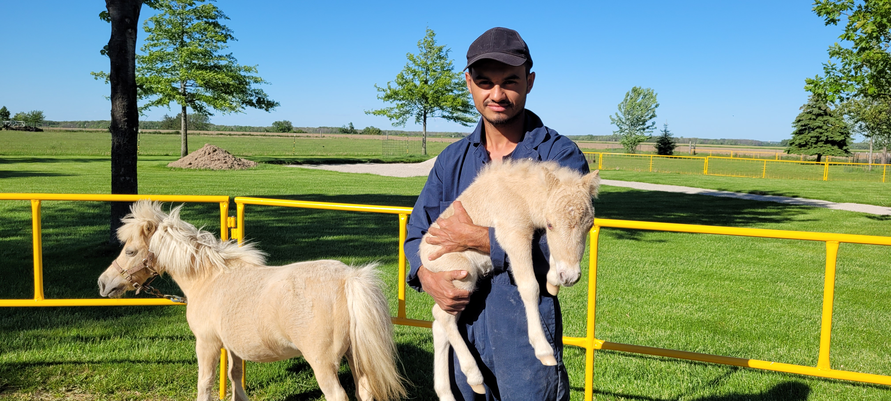
VISA Worker Program
The experience
The downfall
Moving forward
Frontend help
U4U – United for Ukraine
Notes:
#1 - We were blessed with a Christian and honorable person that fast became like family.
And he was an exceptional worker. My husband says the best worker we’ve had in the 17 years we’ve been operating
#2 – Our lovely government makes us go through the entire process again this year
#3 – It was such a good experience, and because we find ourselves always short on the frontend in our admissions & souvenirs
We are in the process of applying for a Ukrainian family to join us this spring

Slide 7
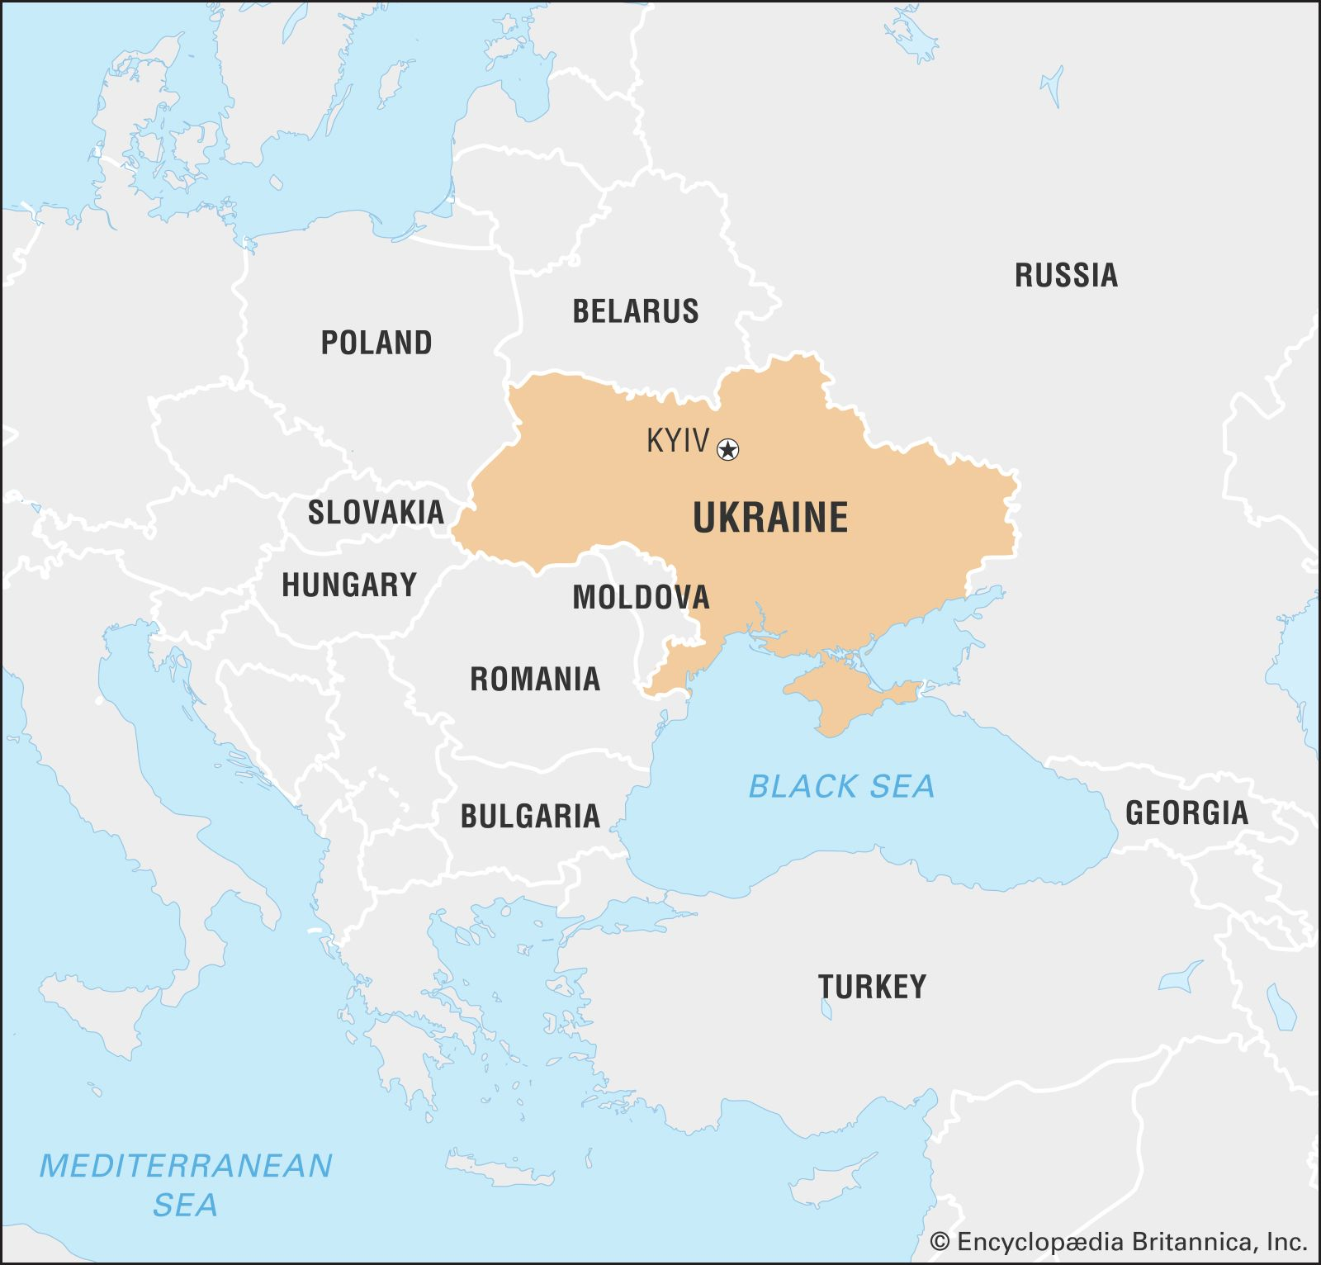
VISA Worker Program
U4U – United for Ukraine
Humanitarian program
US have limited requirements
Application process
I-134a form
Cost
NO application fees
Airfare
Agreement to financially support
Notes:
uscis.gov

Slide 8
VISA Worker Program - H-2A - U4U
Thank you for participating!
Bonnie Keyes, Mulberry Lane Farm

