Slide 1
Post-harvest requirements of fruiting vegetables for prolonged quality and marketability
Yi Wang
Department of Horticulture
University of Wisconsin-Madison

Slide 2
Objectives of Storage Management
Minimize losses
Respiration
Evaporation
Diseases
Maximize value
Quality
Recovery
Rarely improve quality in storage
Depends on quality of harvested crop

Slide 3
Harvesting the produce
Harvest at crop peak maturity or as near as possible
Use only produce that is free from all visible evidence of diseases or insect damage
Handle carefully after harvest to prevent cutting or bruising
Leave an inch or more of stem on most vegetables to reduce water loss and prevent disease infection
Use late-maturing varieties better suited to storage

Slide 4
Storage Design
Insulation
Refrigeration
Humidification
Air flow
Fans
Plenum
Air Quality
O₂
CO₂
Ethylene

Slide 5
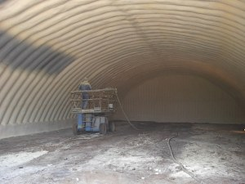
Insulation
Temperature regulation
Improve efficiency of refrigeration
Prevents heat loss
Prevent condensation
Cooling of high humidity conditions
humid air in contact with cold surfaces – O₂ deprivation

Slide 6
Refrigeration
Expensive
Energy intensive
Sized to meet capacity
Volume of produce
Evaporative process
Moving air over refrigeration coils removes moisture from the atmosphere
Outside air
Fall and winter

Slide 7
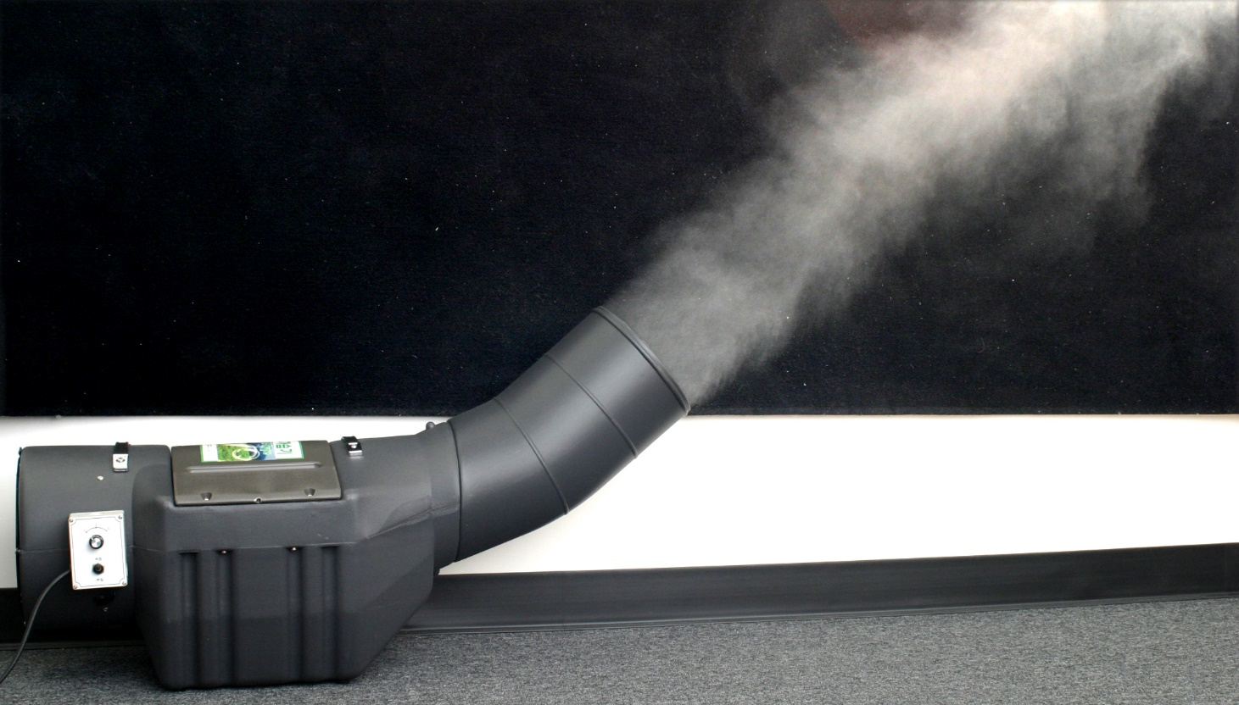
Humidification
Relative humidity
Moisture content relative to maximum
≥ 80%
Absolute moisture content changes with temperature
Warm air has higher moisture capacity
Cool air has lower moisture capacity

Slide 8
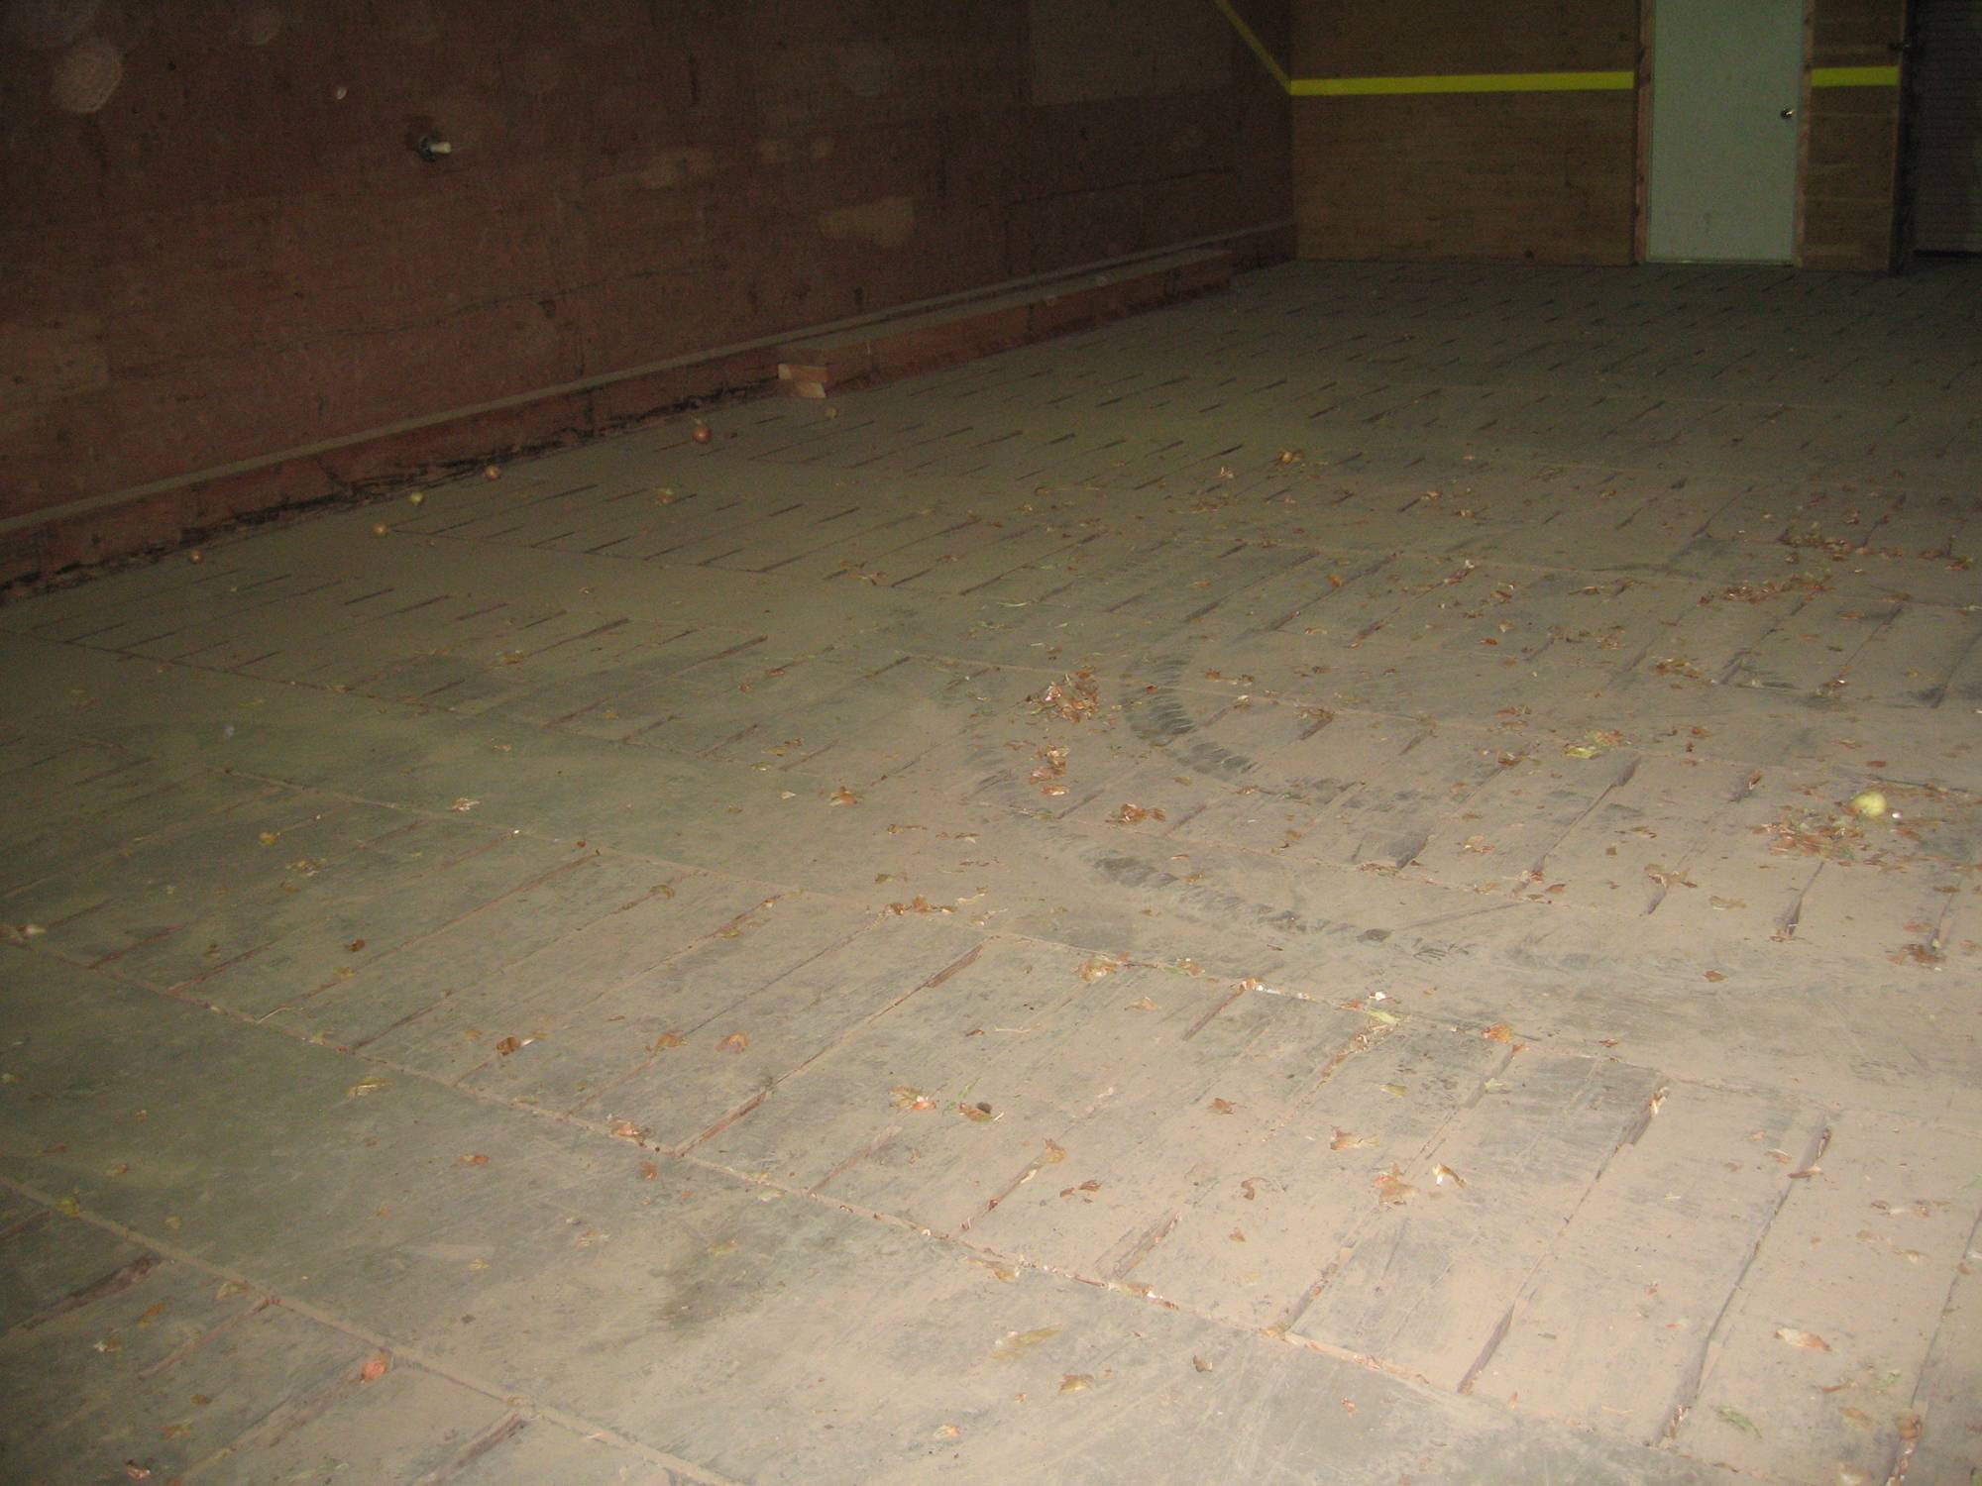
Air flow
Air flow
Fans
Ceiling fans
Box fans
Plenum
Forced air
Pushes air through the produce
Temperature distribution
Uniform
Δt

Slide 9
Air Quality
Oxygen
Low oxygen promotes anaerobic bacteria
Stress some stored produce
Carbon dioxide
Not detrimental by itself
Associated with low oxygen
Ethylene
Promotes ripening
Negative effects on numerous crops
Carrots, potatoes, others

Slide 10
Storage requirements for common fruiting vegetables

Slide 11
 | Temp °F | % RH | Cooling Method | Storage Days | Ethylene sensitive
Sweet corn | 32 | 95–98 | H,I,V | 4–6
Peas, in pods | 32 | 95–98 | F,H,I | 7–10 | Y
Cucumbers | 50–55 | 95 | F,H | 10–14 | Y
Eggplant | 46–54 | 90–95 | R,F | 10–14 | Y
Peppers, bell | 40–55 | 90–95 | R,F | 12–18 | Y
Peppers, hot | 45–50 | 60–70 | R,F | 14–21 | Y
Summer squash | 41–50 | 95 | R,F | 7–14 | Y
Tomato | 62-68 | 90-95 | R,F | 7-28 | Y
F=forced–air cooling , H=hydrocooling, I=package icing, R=room cooling, V=vacuum cooling, N=no precooling needed
Sources: USDA-AMS, Kansas State Extension

Slide 12
Eggplants
Peppers
Onions
Green beans
Sweet corns
Carrots

Slide 13
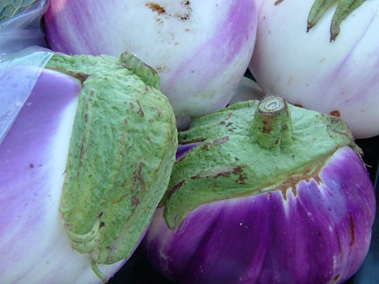
Eggplant – harvest
Harvest tips
Harvest when dry
Can field-pack
Wear cotton gloves, and use to wipe field dust off
Harvest with clippers; keep stem short
Be careful not scratch with nails or stems
Harvest quality
Uniformly egg to globular shape
Fresh green calyx
Firm flesh and dark purple skin or color typical of the variety

Slide 14
Eggplant – storage
50 to 54 °F
Rapid conversion to this temperature
< 1 hr if possible
Within 6 hr for sure
90-95% relative humidity
Sensitive to ethylene
Harvest during cool period of the day
Place in shade
Cool with force air and refrigeration
Damage potential: chilling-injury

Slide 15
Chilling Injury in Eggplant

Slide 16
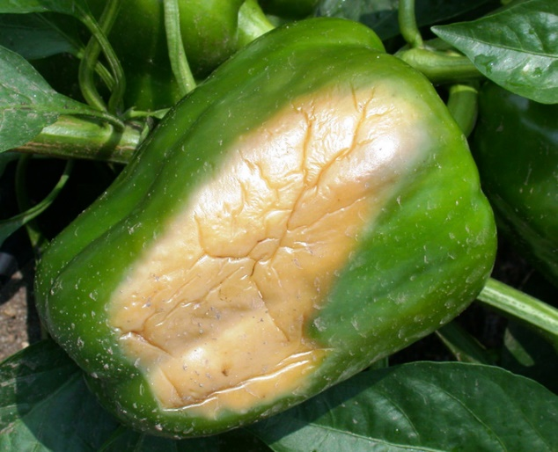
Peppers – harvest
Harvest tips
Harvest when dry
Don’t field pack
Colored peppers should be at least 95% colored
Harvest quality
Uniform shape, size, and color of the variety
Firm flesh, relatively thick with a bright skin color and sweet flavor
Free of cracks, decay, sunburn, and shriveled

Slide 17
Pepper – storage
Pepper fruit is living – “respiring”
Generates heat, CO2, moisture
Respiration influenced by
Storage temperature
Maturation of fruit at harvest
Best quality at harvest
Trying to delay losses in quality

Slide 18
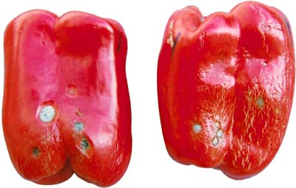
Pepper – storage
45°F and 90-95% humidity
Need to be to storage temperature within an hour of harvest
Cooling with forced air and refrigeration
Warmer temps
Increase disease development
Increase respiration
Cooler temps
Chilling injury
Sensitive to Ethylene

Slide 19
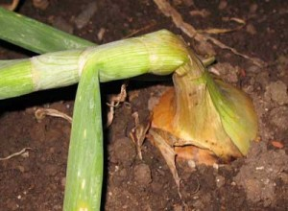
Onion – harvest
Mature onions
Onions dry naturally and top over
70-80 % of plants
Lift onions
Break roots
Dry down tops
Treat with sprout inhibitor

Slide 20
Healthy Onion in Storage

Slide 21
Cure Onions
7 – 14 d
Field cure up to 5 days if no rain, then inside
Remove surface moisture
Form scale leaves
Seal off the neck
Prevent bacterial infection
72°F
Turn on heat at 72°F
Lower RH, dry the bulbs
Ventilated

Slide 22
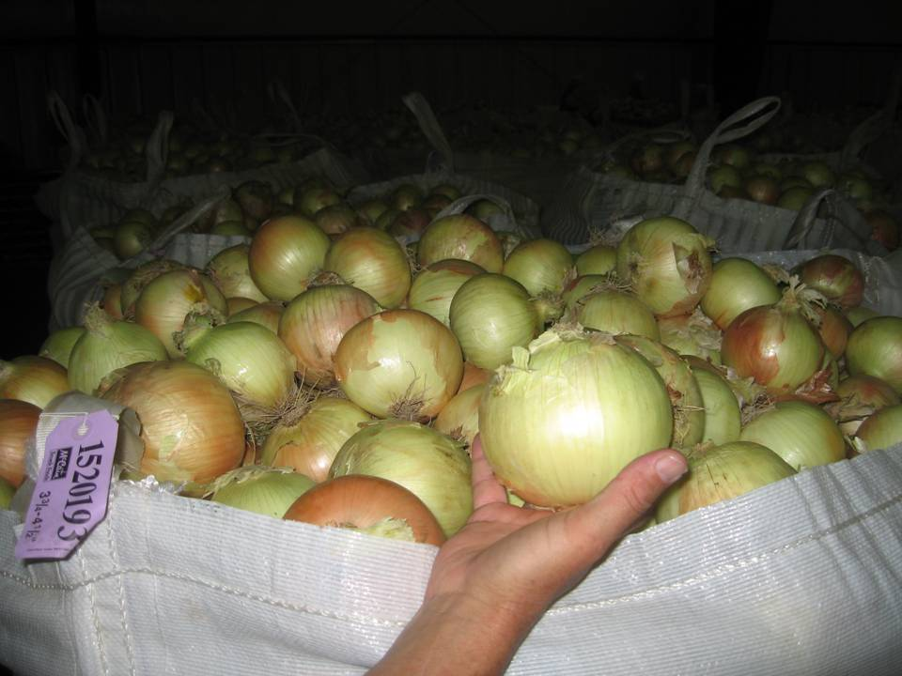
Onion – long-term storage
Cool down to 32 – 36°F
Closer to 36°F
Buffer to avoid freezing
65-75% Humidity
Not sensitive to ethylene although high doses can induce sprouting
Store for 6+ months

Slide 23
Green Bean – harvest
Harvest tips
Harvest every 2-4 days
Don’t harvest when wet
Shipping boxes can be filled directly from harvest containers if beans clean
Keep stem-ends intact when picking
Beans don’t get too hot or too cold
Beans are tolerate to harvest in the heat of the day

Slide 24
Green Bean – harvest
Harvest quality
Well-formed turgid and straight pods tender and bright in color
Full bean cavity
Seeds that are too large or pods that are fibrous are too old to harvest
Harvest maturity
Average time until maturity is 50-60 days and usually 15-18 days following full bloom of the plants flowers

Slide 25
Optimal Green Bean Harvest

Slide 26
Optimal – storage
41-46°F
Hydro-cooling recommended
Forced air
95-100% Humidity
5% weight loss leads to limp and shriveled beans
10% weight loss unmarketable
Water loss, chilling injury, decay
Sensitive to ethylene exposure

Slide 27
Green Bean Ethylene Response
Loss of green pigment
Increased browning
> 0.1 ppm can reduce shelf-life by 30-50% at 41°F

Slide 28
Chilling Injury of green beans

Slide 29
Sweet Corn
Super sweet varieties
Sh2 gene
Extended shelf life
Delayed conversion of sugars
Maintenance of flavor

Slide 30
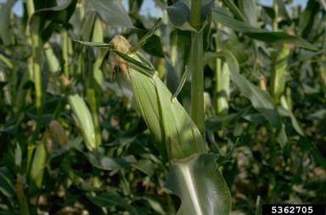
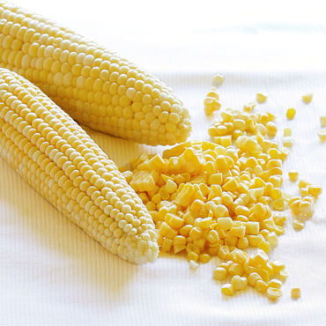
Sweet Corn Maturity
Silks are dried
Immature kernels
Moisture content of kernels
Milky not doughy
70-75% moisture for standard
77-78% for super sweet varieties

Slide 31
Sweet Corn – harvest
Harvest tips
Early in the day when still cool
Put directly into the cooler
Can be iced in the field
Can be field-packed
Husks not protect corn, bruises will show up later if tossed or squeezed
Not let corns heat up, keep them in the shade
The faster the corns are cooled, the better they hold sweetness – sensitive to overheating

Slide 32
Sweet Corn – harvest
Harvest quality
Uniform appearance
Filled kernels in rows
Firm ears
Plump milky kernels
Free of defects
Insect injury
Mechanical damage
decay
Trimmed husks with tight appearance

Slide 33
Sweet corn – storage
32 to 34°F
Standard sweet corn – 7 d
Super sweet varieties – 21 d
Humidity: 95-98%
Rapid cooling
Remove field heat
Hydro-cooling
Icing

Slide 34
Carrot – harvest
Harvest tips
Loosen with a fork or a bed lifter before harvesting
Cull hairy carrots – bitter
Cull forked carrots
Harvest quality
Partially mature, ½ - ¾’’ at shoulder
Firm, straight from shoulder to tip
Smooth with little residual “hairiness”
Sweet with no bitter or harsh taste
Show no signs of cracking

Slide 35
Carrot storage losses
Shrink
Loss of moisture
Evaporation
Loss of carbohydrate
Respiration
Sprouting
Bud development on carrot roots
Increases potential for moisture loss
Storage diseases
Flavor
Bitterness

Slide 37
Carrot – temperature management
32-33ºF
Maintain at 34ºF
Minimizes sprout development of carrots
Minimizes respiration
29.5ºF minimum temperature

Slide 38
Carrot – humidity management
99% Humidity
99% required for fresh market carrots
Turgidity more important in fresh carrots
95% used for processing
Tolerate higher water loss
Free moisture at 99% humidity and 33°F

Slide 39
Carrot – air quality during storage
O₂:CO₂
Ethylene
Short durations at low levels cause bitterness
Other flavor, storability, quality factors
Damage potential of carrots are low

Slide 40
Summary of today’s talk
Harvest the crops with best quality, under required conditions, free of potential problems
Storage factors
Temperature
Relative humidity
Air flow and air quality
Variety selection is important

Slide 41
Thank you

