Slide 1
Wisconsin NRCS Programs
Jan 28, 2020 | Ryan Gerlich, Resource Conservationist, Madison, WI
Notes:
GO TO VIEW > MASTER > SLIDE MASTER TO EDIT THE IMAGES ON THE TITLE AND DIVIDER SLIDES
RIGHT CLICK ON THE INDIVIDUAL IMAGES TO CHANGE THE IMAGE

Slide 2
Who is the USDA – NRCS?

Slide 3
Conservation Planning and Financial Assistance Programs
Environmental Quality Incentives Program (EQIP)
Conservation Stewardship Program (CSP)
Conservation Reserve Program (CRP) (administered by the Farm Service Agency)
Ag Conservation Easement Program (ACEP)
Conservation Technical Assistance (CTA)

Slide 4
Conservation and Production
NRCS does NOT offer financial assistance to a crop farmer to plant corn, and likewise would not offer financial assistance to plant or establish trees/shrubs for production purposes
Good Conservation equals good production into the future

Slide 5
Environmental Quality Incentives Program (EQIP)
~ 118
conservation practices
offered this year.
Includes plans for Irrigation Water Mgt and Pest Management

Slide 6
Environmental Quality Incentives Program (EQIP)
ELIGIBILITY:
USDA (HEL/WC, AGI, FTE)
Resource Concern
Land Control
Land Use
Grassed waterway ending in a wetland scrape

Slide 7
Environmental Quality Incentives Program (EQIP)
Flat rate payments for conservation practices.
Pollinator Habitat pays anywhere from $525/acre to $735/acre

Slide 8
Environmental Quality Incentives Program (EQIP)
Sign-Up year round at any NRCS office (Feb 28th and June 5th)
Applications “scored” twice per year, when funding arrives in State. Top scoring applications are funded.

Slide 9
Environmental Quality Incentives Program (EQIP)
High Tunnel System
$3.14/sq-ft
Up to $10,000
Associated Practices;
Diversion
Grassed Waterway
Irrigation
Soil Health

Slide 10
Environmental Quality Incentives Program (EQIP)
Other Practice types that may be of interest to Fruit/Berry Growers;
Conservation Activity Plans (CAPS)
Technical Service Provider (TSP)
Integrated Pest Management
$1,516 / plan (size variations)
Nutrient Management
$1,820 / plan
Irrigation Water Management
$1,268 each for 30 acres or less

Slide 11
Environmental Quality Incentives Program (EQIP)
Cover Crops
$26 - $53/ ac, depending on the mix

Slide 12
Conservation Stewardship Program (CSP)
CSP helps you build on your existing conservation efforts while strengthening conservation on your operation.
Whether you are looking to improve grazing conditions, increase crop yields, or develop wildlife habitat, we can custom design a CSP plan to help you meet those goals.
Highest payments go towards participants who have a current conservation plan, are following a nutrient management plan, are managing for soil health with reduced tillage and cover crops and have field setbacks from surface water.

Slide 13
CSP Activities/Enhancements
Other popular CSP activities include;
Cover crops for soil health
Leaving a small stand of unharvested grain to benefit wildlife
Managing fencing for wildlife.
Creating forest openings to create linear variety in the forest
Forest understory plantings to create verticle variety in the forest

Slide 14
EQIP or CSP Programs -
Improved cattle gains per acre
Prescribed Grazing, Fencing, Livestock Water, Pipeline
Increased crop yields
Nutrient and Pest Management, Cover Crops, Crop Rotation, No-Till
Decreased inputs
Nutrient and Pest Management, Irrigation Water Management
Wildlife population improvements
Wildlife Plantings, Stream Habitat, Nesting Boxes
Better resilience to weather volatility
Soil Health Principles
Armoring the Soil (always covered)
Minimizing Soil Disturbance
Plant Diversity
Continual Living Root System

Slide 15
Wildlife Habitat
Monarch and Pollinator Habitat
Conservation Cover
Wildlife Habitat Planting
Forage and Nectar Species

Slide 16
How to Apply
Submit an Application at your local NRCS Service Center.
EQIP: Feb 28th
CSP: TBA

Slide 17
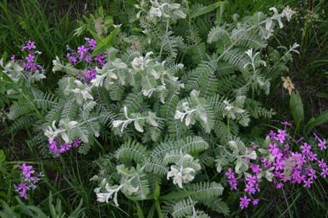
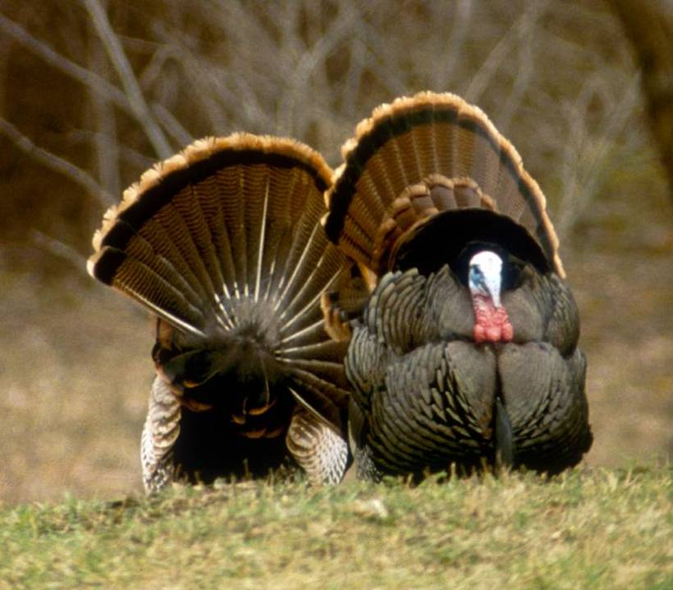
Conservation Reserve Program
Rental payments for establishing and maintaining conservation cover
Signups are held periodically by the Farm Service Agency (FSA)
Signup Deadline: Feb. 28th

Slide 18
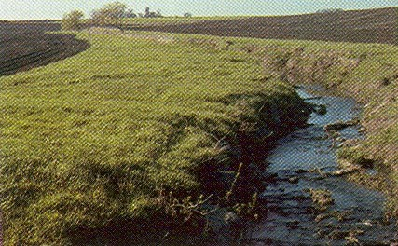
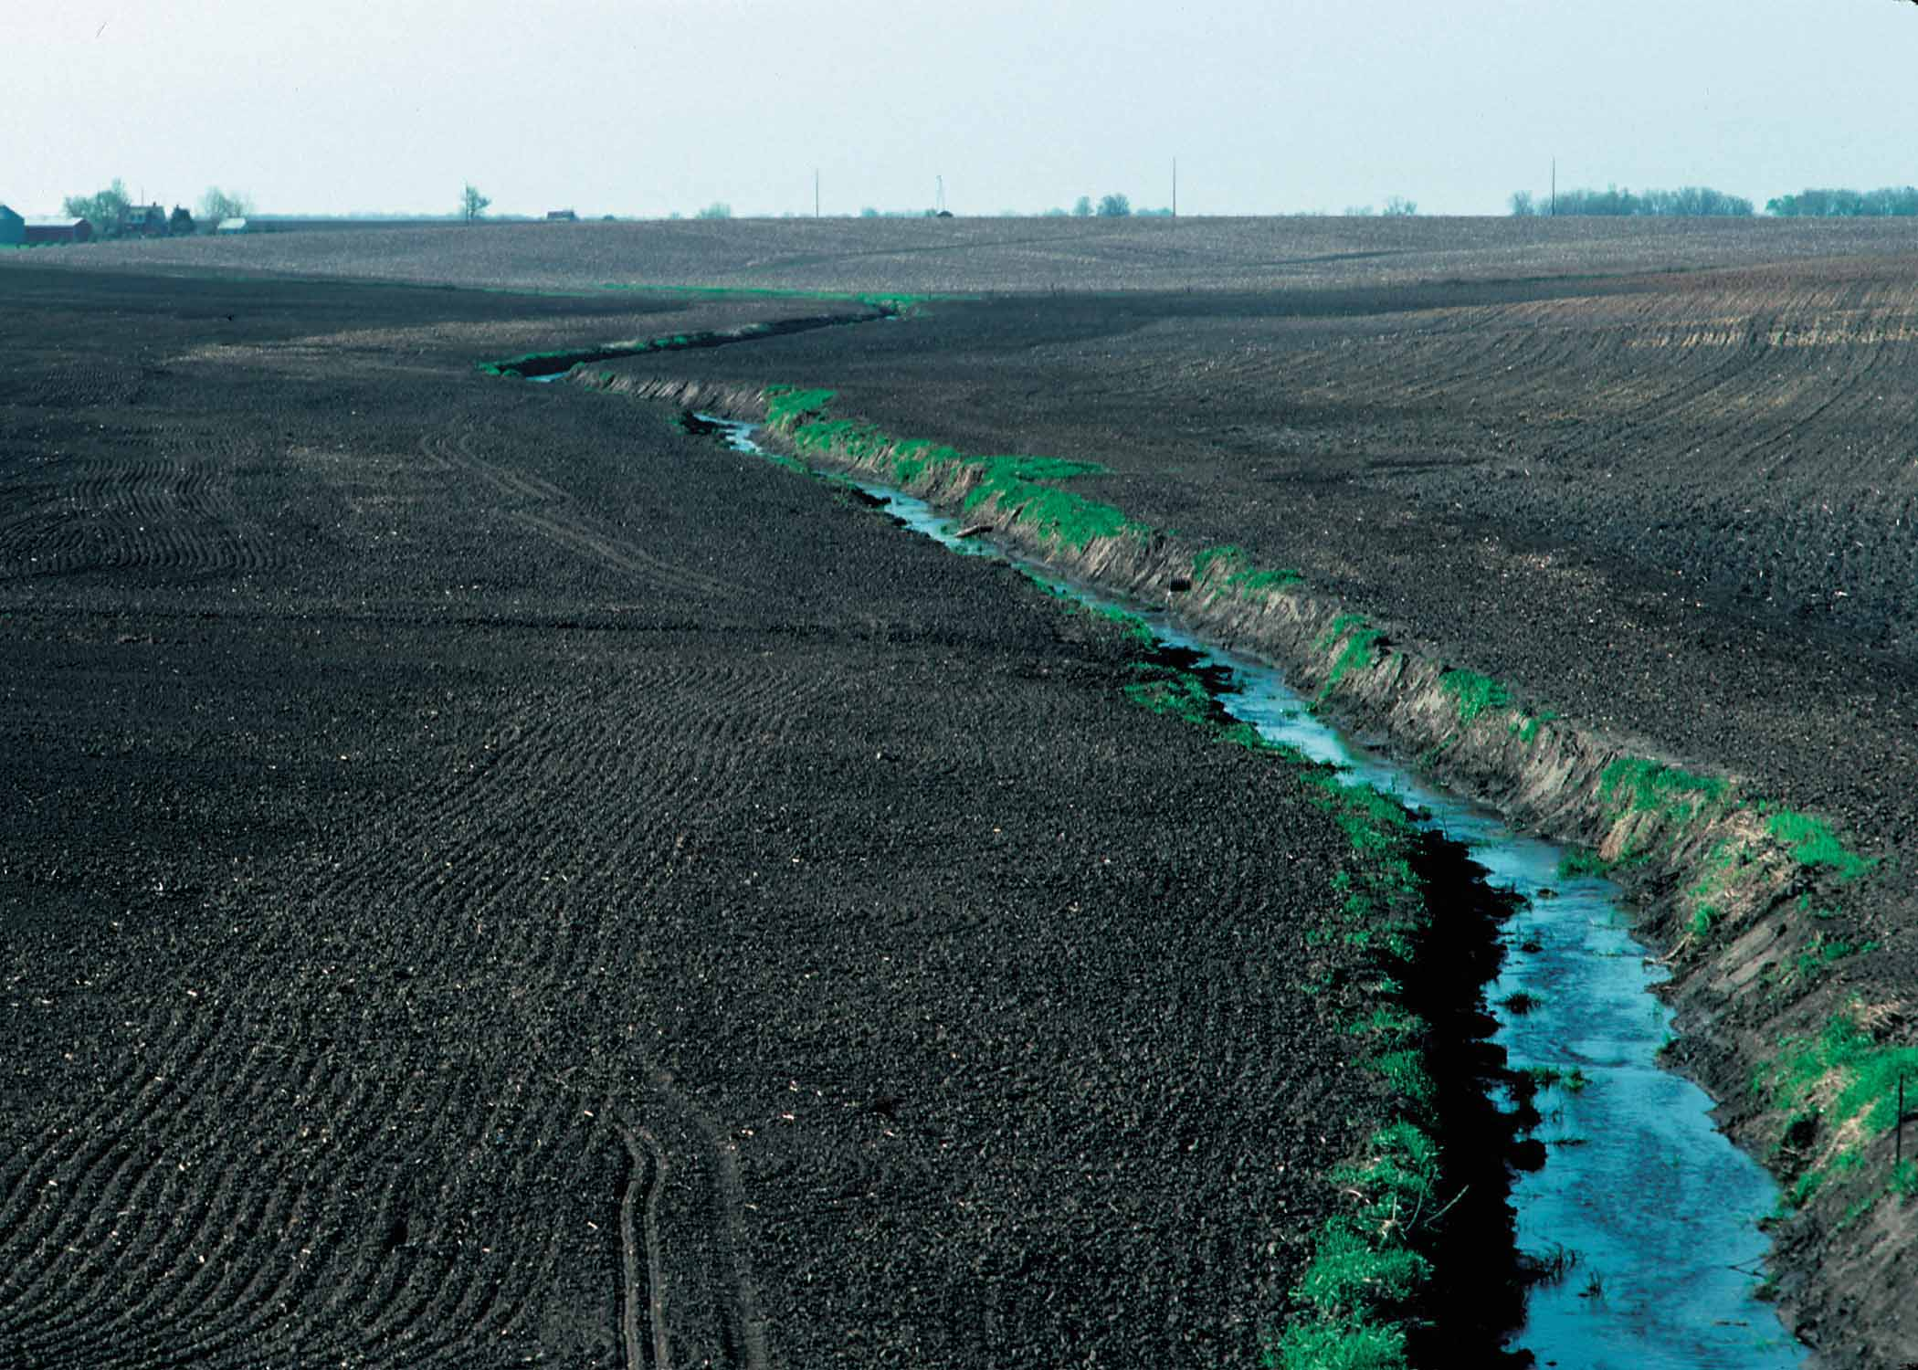
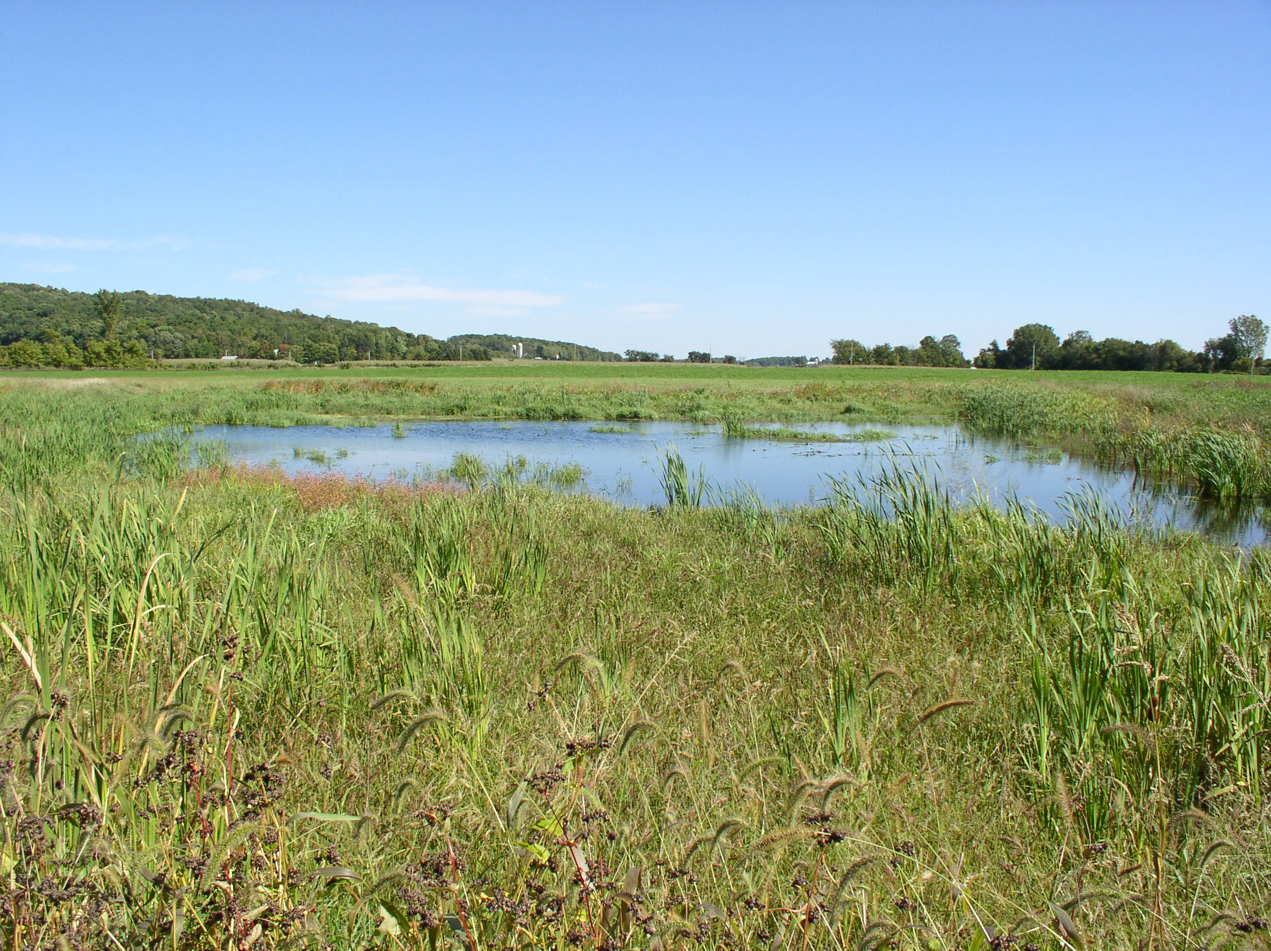
Conservation Reserve Program: CCRP and CREP
- Buffers for streams & ditches (planted to trees or grass) - Shallow Water Areas for Wildlife - Windbreaks / Shelterbelts

Slide 19
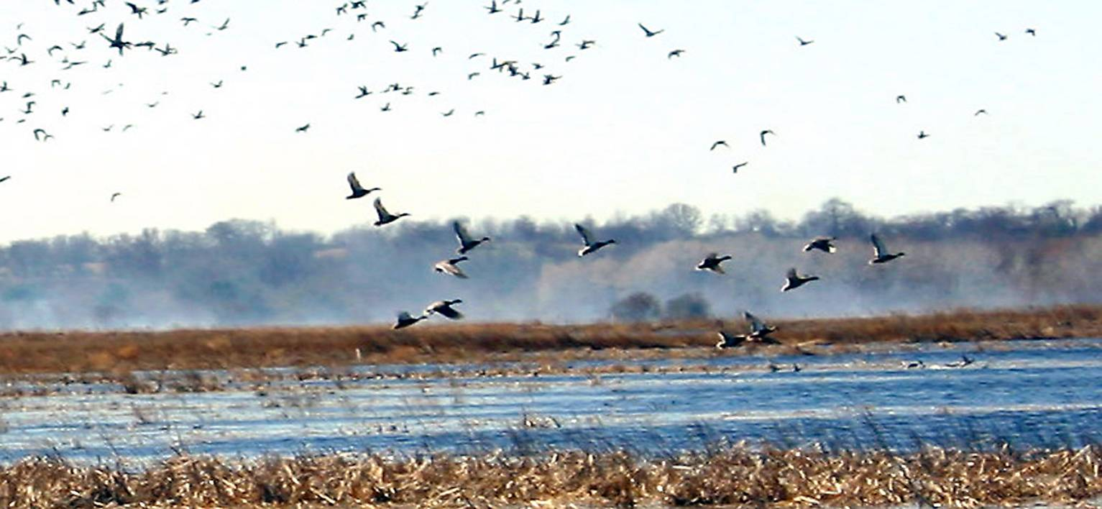
Ag Conservation Easement Programs
Permanent or 30 Year Easements for Wetlands. (Government Held Easement)
Permanent Easements for Farm Land (requires a sponsor)

Slide 20
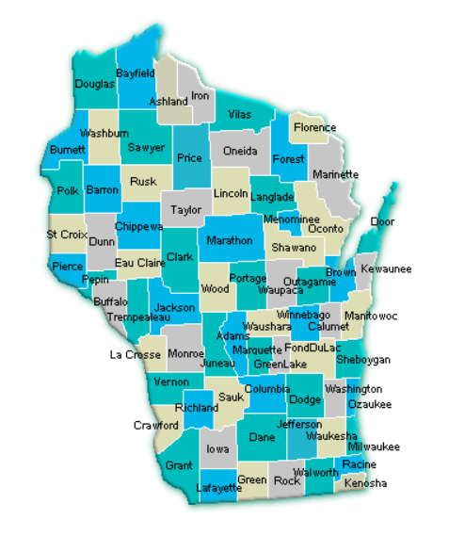
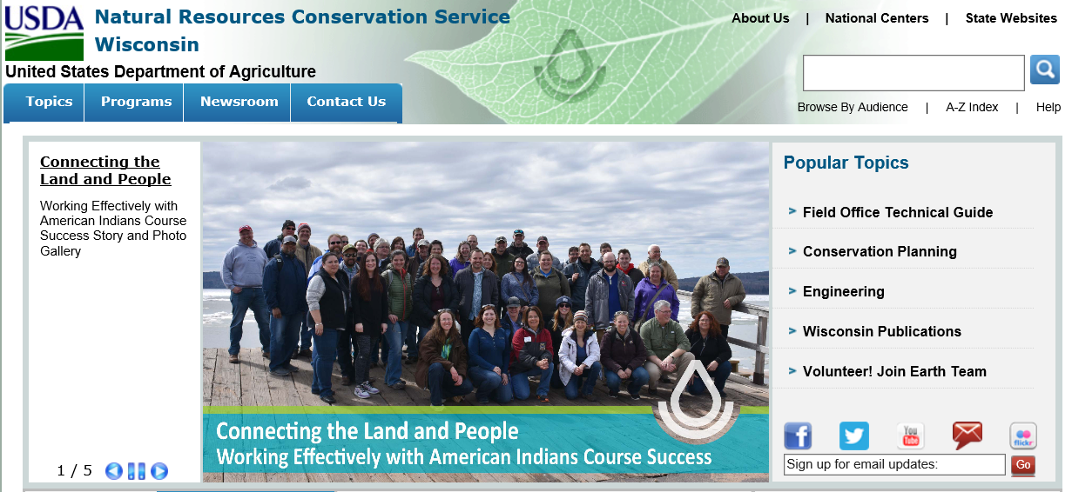
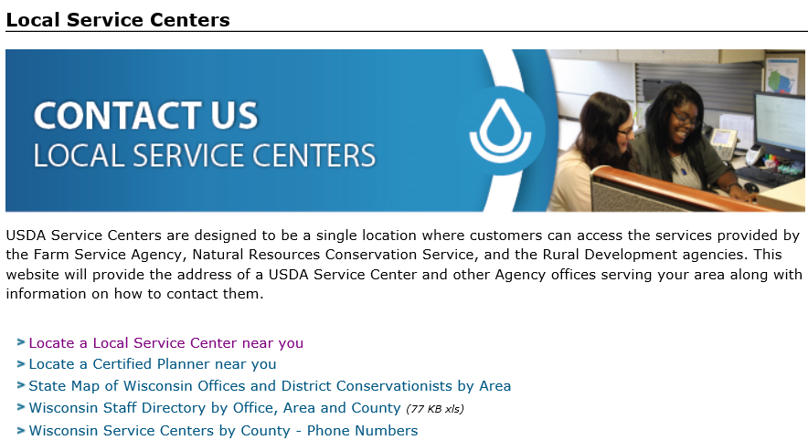
How to find your local NRCS office
Start here: www.wi.nrcs.usda.gov

Slide 21
NRCS – Helping People Help the Land
USDA is an equal opportunity provider, employer, and lender.

