Slide 1

2019
EXOTIC & INVASIVE
VEGETABLE PEST
DETECTION
ADRIAN BARTA
DATCP PEST SURVEY PROGRAM

Slide 2

datcp
DATCP PEST SURVEY PROGRAM
The Pest Survey was established in 1915 to:
1. Detect new or regulated exotic pests
2. Support export certification
3. Collect data on economic pests of WI crops
Notes:
“My dad looks for things that aren’t there, and is happy when he doesn’t find them.”

Slide 3
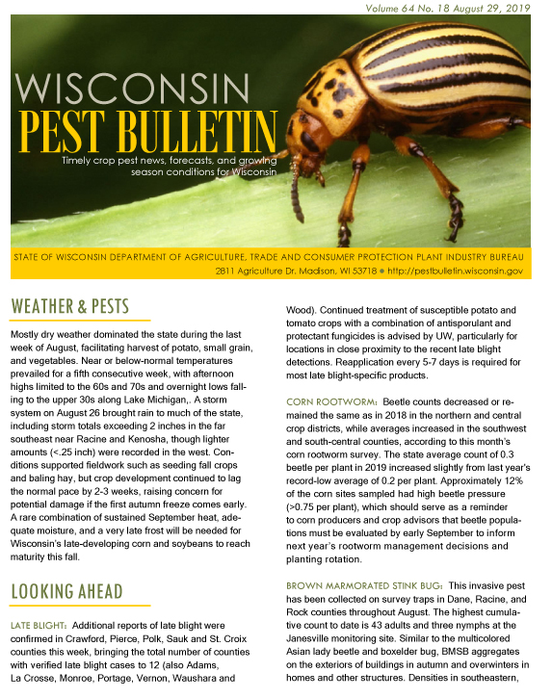
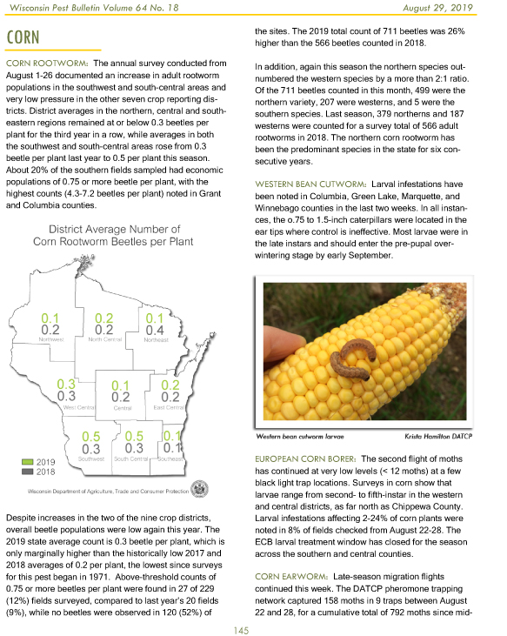
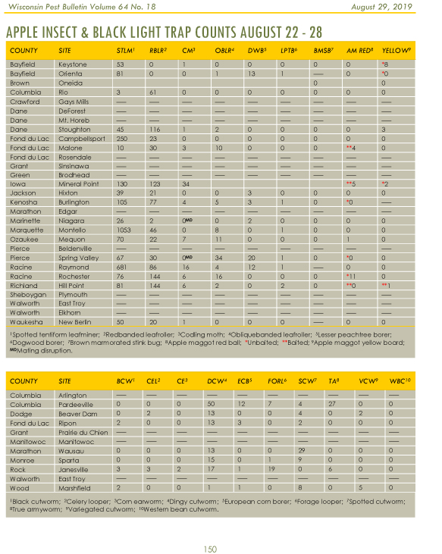
datcp
Notes:
?—How many readers in audience?
Subscribe for email notification of each weekly issue (in season)

Slide 4
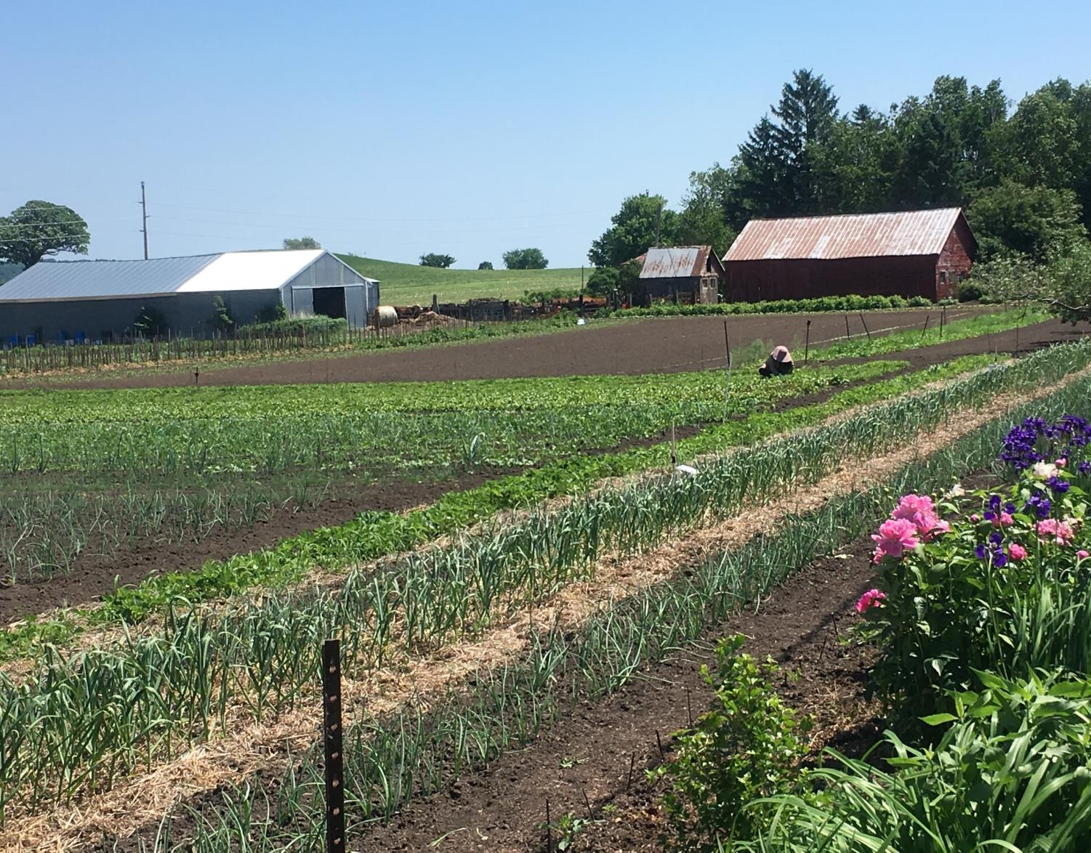
Pathways Survey 2018-2019
For vegetable component, an urban focus:
Community gardens
Community-Supported Agriculture (CSA) farms .Orchards
Apple
Grape
Cherry
Blueberry
Supported by a Farm Bill grant administered by USDA-APHIS
Notes:
Targeting exotic pests not known to occur in Wisconsin
Working with non-traditional growers and seed sources?

Slide 5
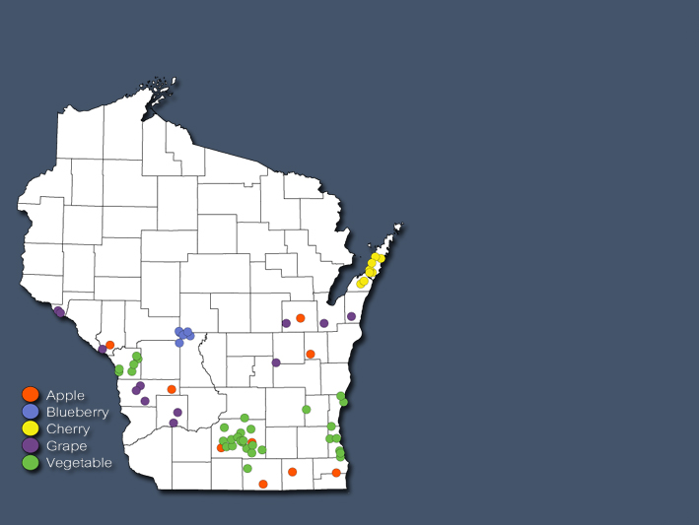
datcp
PATHWAYS SURVEY SITES 2018
24 counties
366 traps
70 sites:
- 09 Apple
- 12 Grape
- 08 Cherry
- 06 Blueberry
- 35 Vegetable

Slide 6
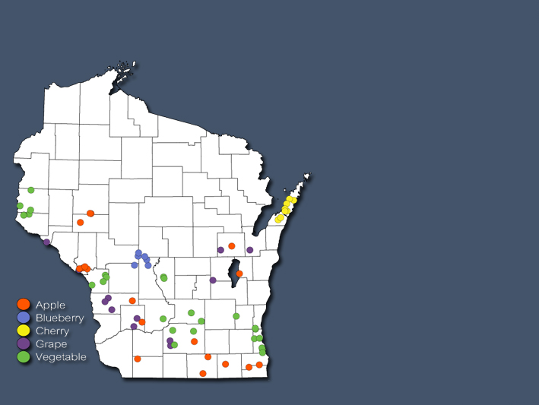
datcp
PATHWAYS SURVEY SITES 2019
31 counties
461 traps
76 sites:
- 18 Apple
- 12 Grape
- 08 Cherry
- 06 Blueberry
- 32 Vegetable

Slide 7
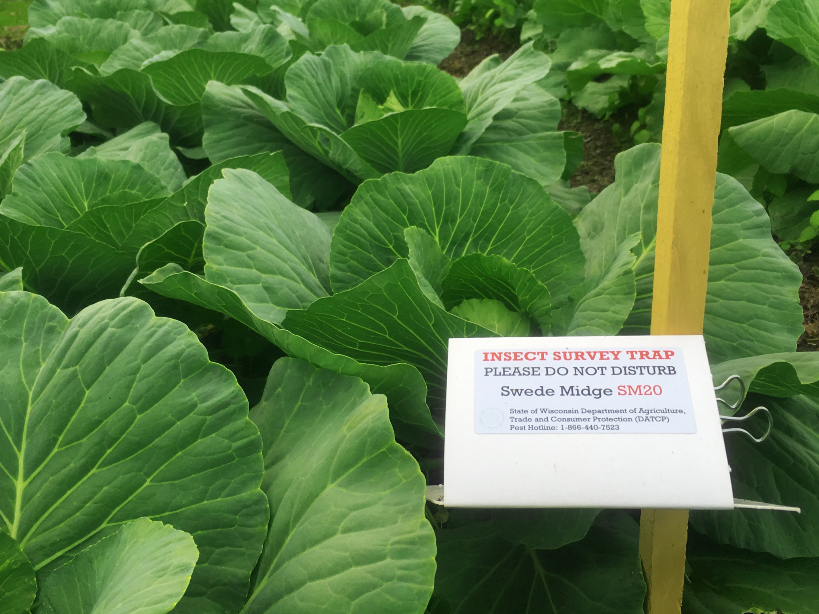
PATHWAYS SURVEY 2019
TARGET INSECT PESTS
Cucurbit beetle (Diabrotica speciosa)
False codling moth (Thaumatotibia leucotreta)
Golden twin spot moth (Chrysodeixis chalcites)
Leek moth (Acrolepiopsis ass ectella)
Swede midge (Contarinia nasturtii)
Notes:
When we began the survey, none were known to occur in Wisconsin
CB-not in N America
FCM-Not in US
GTS-Not in US (Ontario)
LM- Present in NY State
SM-rapidly becoming widespread, including WI

Slide 8
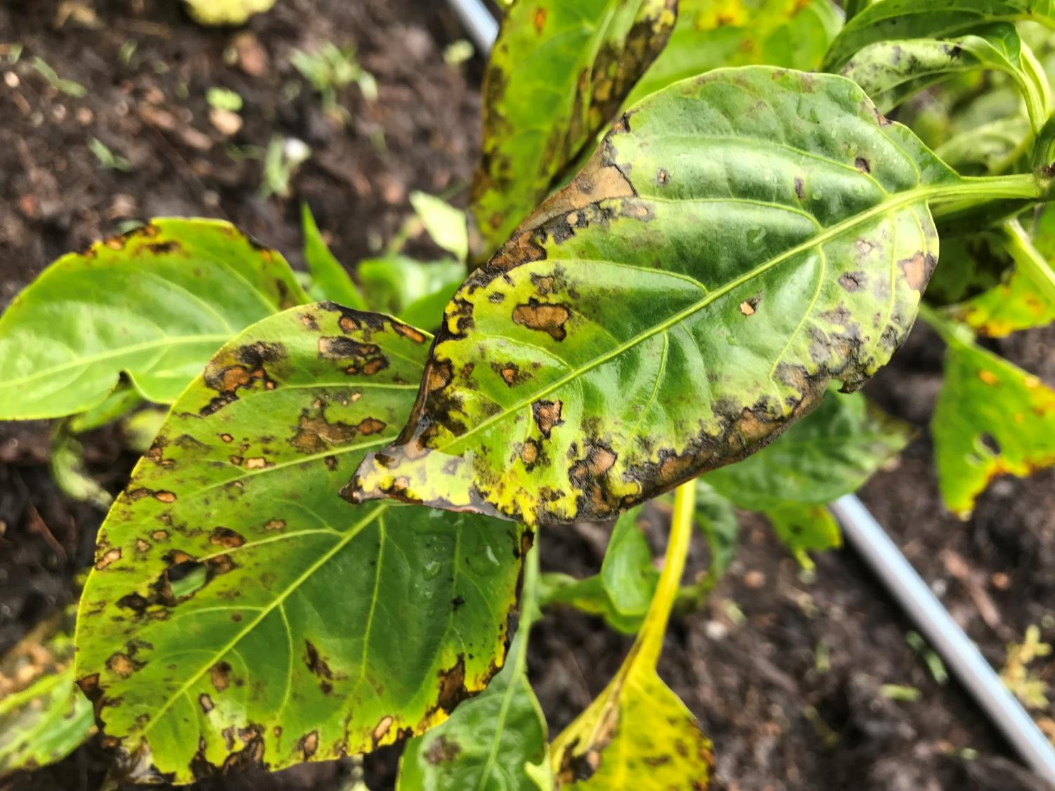
PATHWAYS SURVEY 2019
TARGET DISEASES
Bacterial wilt of tomato
Cucurbit downy mildew
Cucumber green mottle mosaic
Java downy mildew
Late blight
Philippine downy mildew
PSTVD, TCDVd
Stem and bulb nematode
Notes:
All exotic diseases except for:
late blight (regulatory significance)
stem and bulb nematode, of limited occurrence in the state,
Potato Spindle Tuber Viroid, considered eradicated from WI in 2013.
Bacterial wilt concern is race 3, biovar 2—included in the Agriculture Bioterrorism Act of 2002 as a Select Agent potential bioterrorism organism

Slide 9
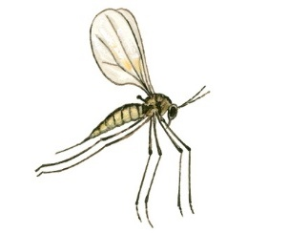
FIRST WI SWEDE MIDGE DETECTION
Two trap samples were identified
as the invasive swede midge
Contarinia nasturtii (Keiffer)
Dane County June 17, 2019
Milwaukee County on July 1
Jackson traps set in broccoli
Notes:
640 traps checked every other week for months--10 insect traps at 32 sites over 2 years,—we caught two midges
Community gardens in both cases, Milwaukee a broccoli patch raised for the food pantry.

Slide 10
SWEDE MIDGE
BACKGROUND
Native to Europe and Asia, and was first detected in North America in Toronto, Canada, in 2000
Spread to New York in 2004, and was recently found in Minnesota (2016) and Illinois (2017)
Notes:
Swede midge is expected to significantly impact brassica production in the state as it becomes more widely established

Slide 11
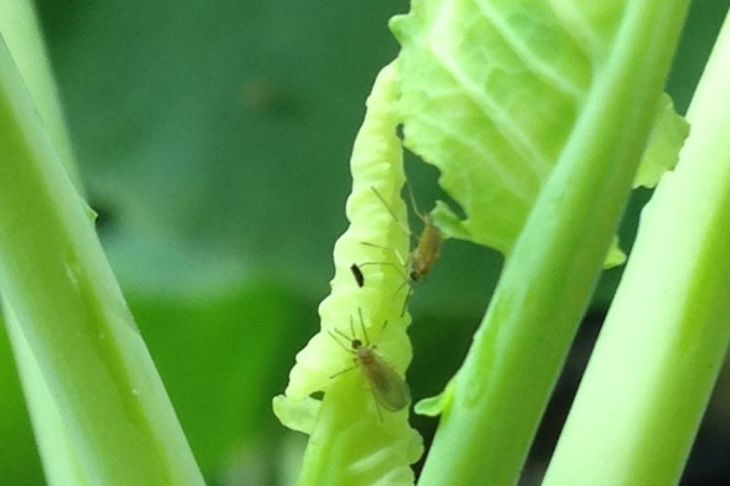
SWEDE MIDGE FLIES
Dave Fuller UMaine Cooperative Extension
Notes:
About 1.5-2 mm in size-requires good hand lens to observe
4 or 5 overlapping generations in Ontario
Not strong fliers, but can move several hundred feet

Slide 12
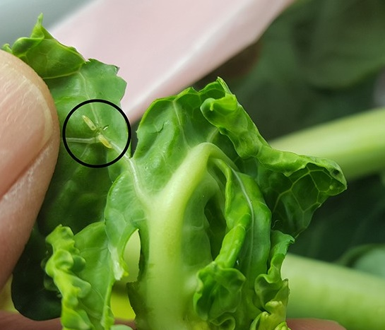
SWEDE MIDGE LARVAE
Dave Fuller UMaine Cooperative Extension

Slide 13
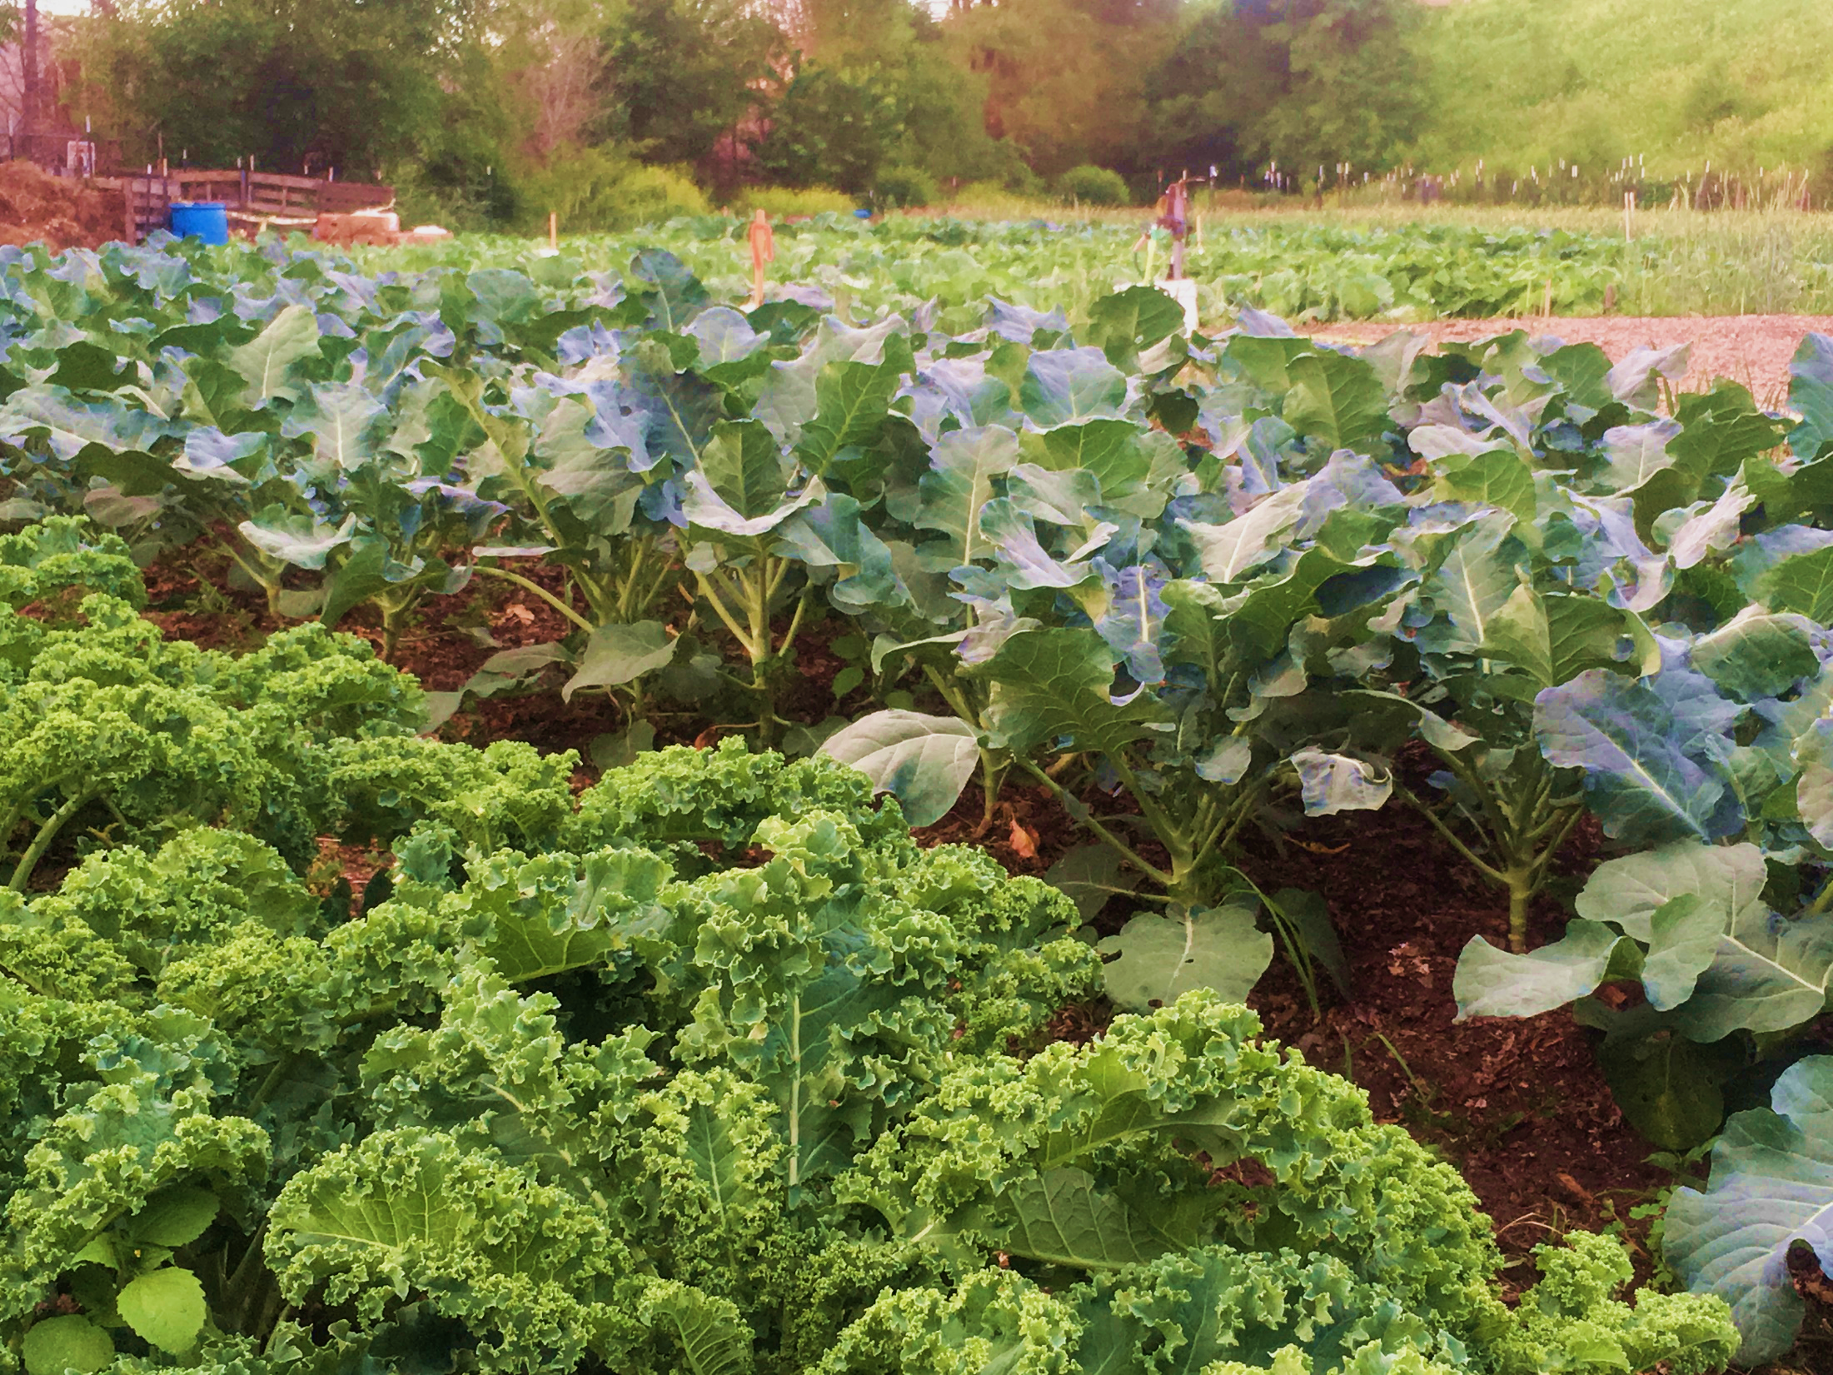
SWEDE MIDGE HOSTS
Nearly all vegetable crops in
the mustard family:
  Broccoli
  Brussels sprouts
  Cabbage
  Cauliflower
  Kale
  Mustard greens, collards
  >20 weed species: wild
  radish, shepherd’s purse,
  field pennycress, yellow rocket, etc.
Notes:
broccoli, Chinese broccoli, Brussels sprouts, cauliflower, Chinese cabbage and collards are most susceptible

Slide 14
SWEDE MIDGE HOSTS
Nearly all vegetable crops in
the mustard family:
  Broccoli
  Brussels sprouts
  Cabbage
  Cauliflower
  Kale
  Mustard greens, collards
  >20 weed species: wild
  radish, shepherd’s purse,
  field pennycress, yellow rocket, etc.
Notes:
Most susceptible. Also Chinese broccoli, Chinese cabbage….

Slide 15
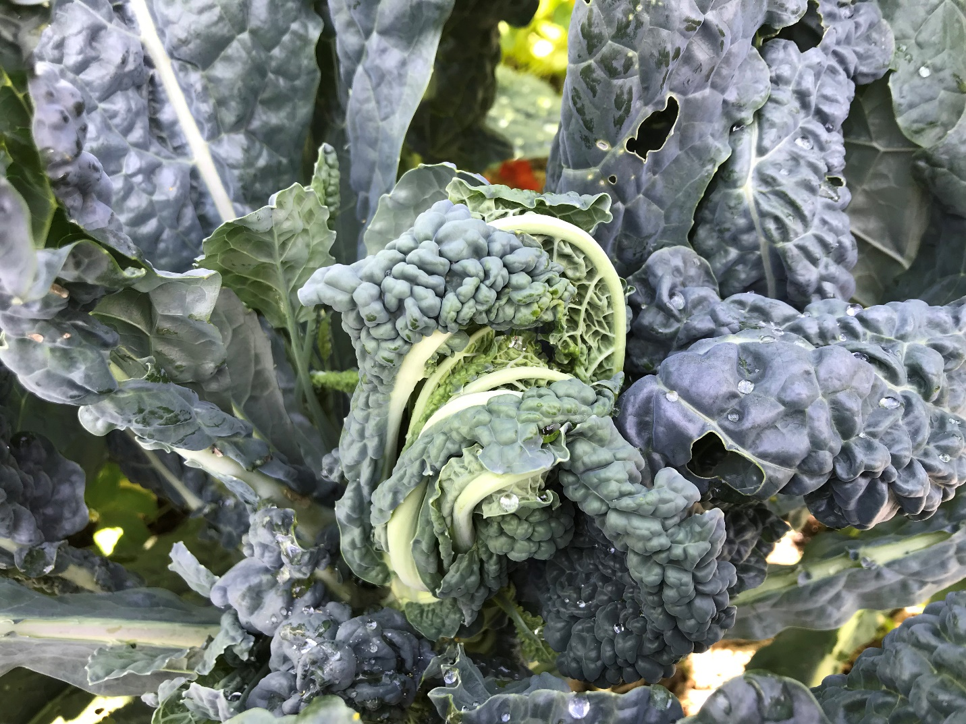
DAMAGE: stunted or distorted growing points
Notes:
The midge larvae attack the growing point, causing significant damage

Slide 16
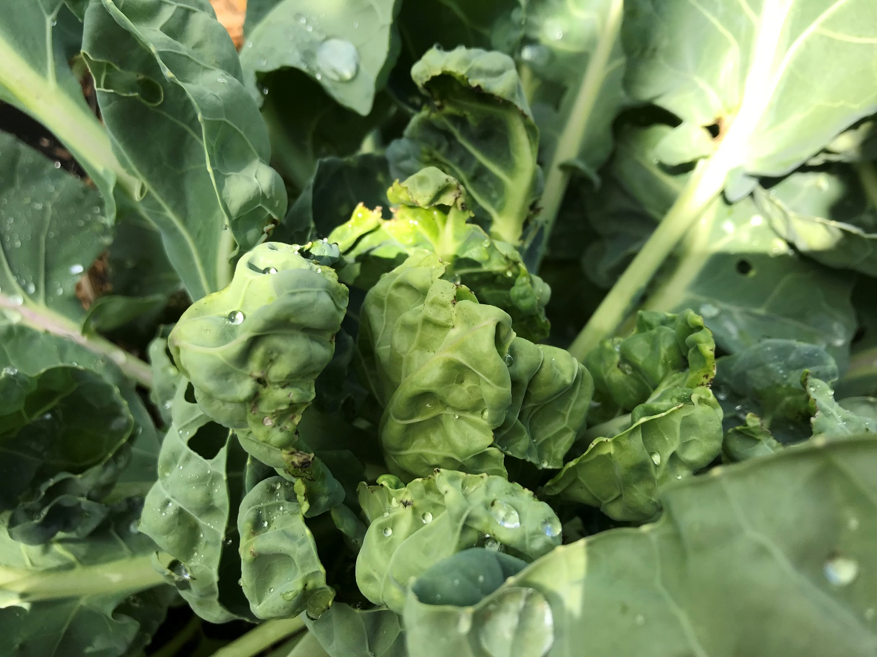
DAMAGE: stunted growing point

Slide 17
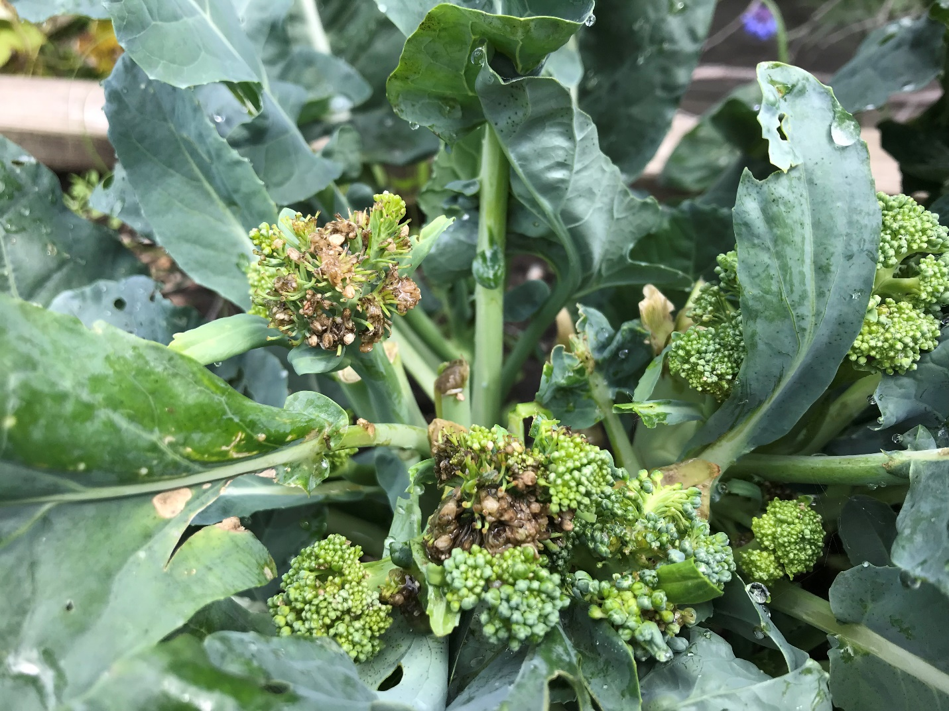
DAMAGE: brown scarring at growing point

Slide 18
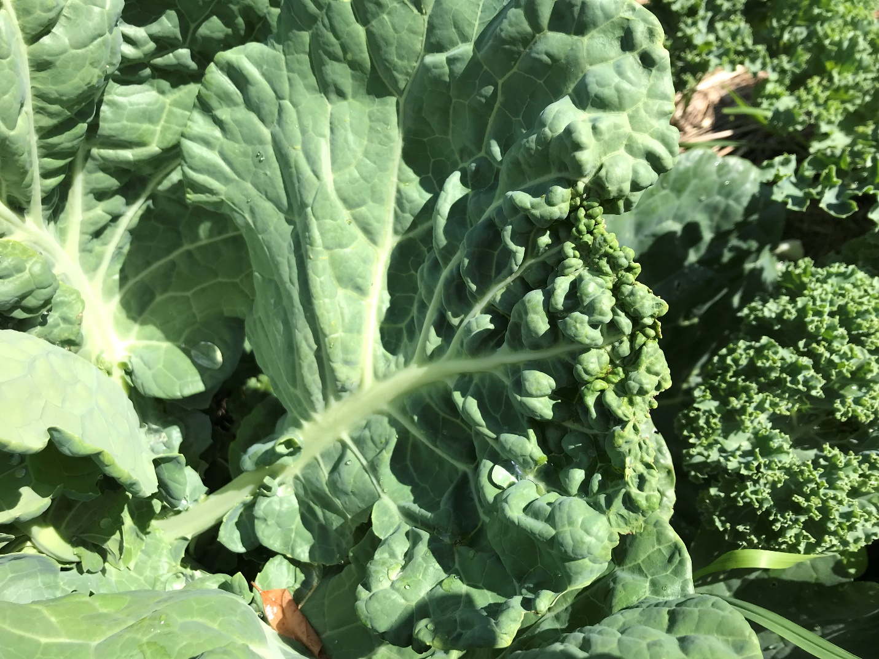
DAMAGE: leaf puckering

Slide 19
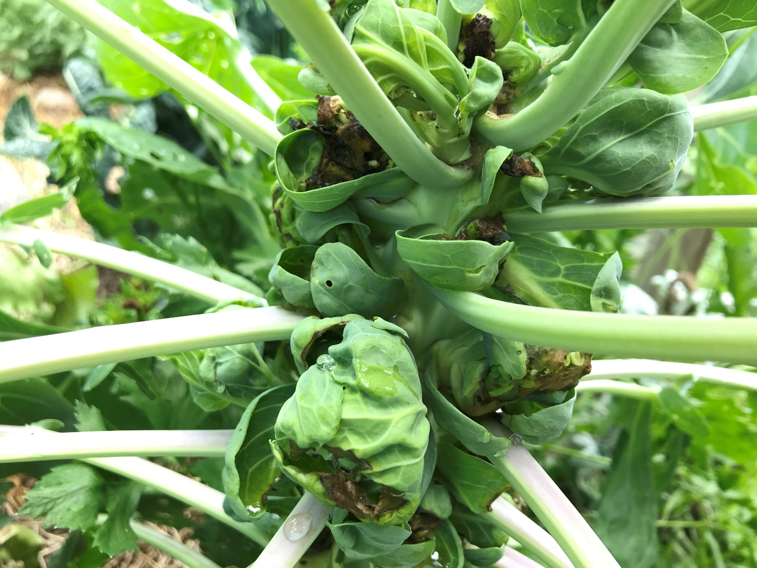
DAMAGE: secondary bacterial rots
Notes:
Opens plant to secondary invaders

Slide 20
datcp
SWEDE MIDGE LIFE CYCLE
Overwinter as pupae in soil
First generation emerges mid-May to mid-June
After mating, females lay 2-50 eggs on youngest, actively growing tissue
Larvae take 10-12 days to complete development
Pupation can take 7-14 days in growing season
Notes:
Females may lay 100 eggs in a 4 day life span
As almost everything biological, rates of development are dependent upon temperature

Slide 21
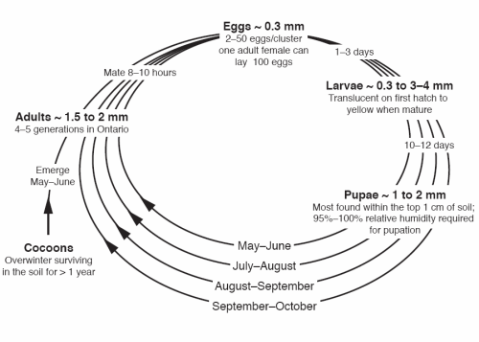
Image: OMAFRA Fact Sheet 08-007
Life cycle is 21-44 days per generation

Slide 22
datcp
MANAGING SWEDE MIDGE
Crop rotation
Crop selection
Field sanitation
Planting and harvest dates: Early-season crucifer crops may avoid some damage.
Notes:
Will defer specific recommendations to Russ Groves and Extension in the future, but here are guidelines from NY and elsewhere:
Rotation is the single most effective way to reduce swede midge populations in the field, but may require 600 yards or more
Some differences have been noted between varieties within crops
Cruciferous weeds act as reservoirs in absence of host crop
Avoid late-season crops to help reduce overwintering population

Slide 23
REPORTING SWEDE MIDGE
TO REPORT A SUSPECTED SWEDE MIDGE INFESTATION NEXT SEASON PLEASE CONTACT:
PJ Liesch, UW Madison
Insect Diagnostic Laboratory
Or
Your county Ag Extension agent (who will pass your report on to PJ….)
Or
Krista Hamilton, WI DATCP
Krista.Hamilton@wisconsin.gov
(866) 440-7523 DATCP Pest Hotline

Slide 24
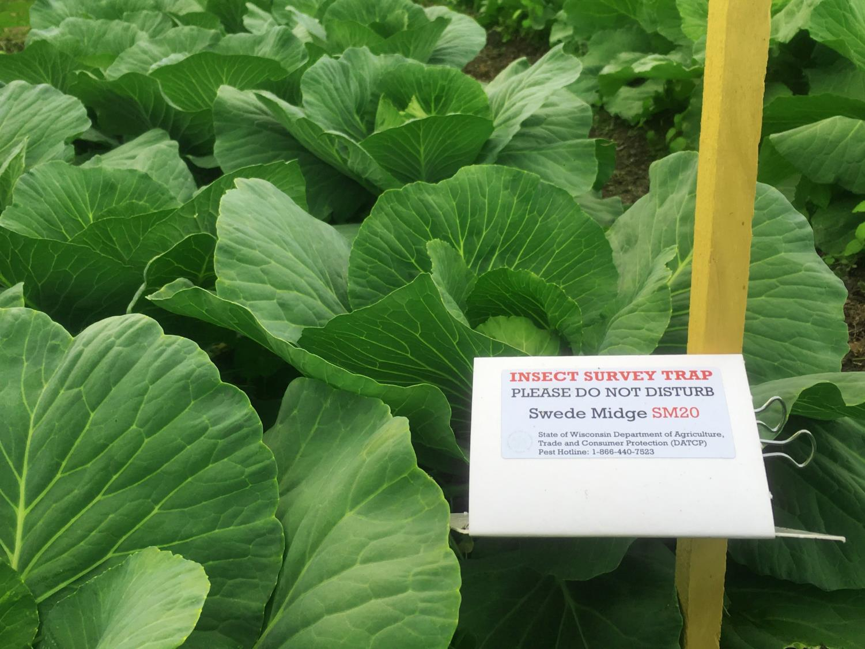
OTHER SURVEY FINDS
IN 2019:
Late blight on tomato at CSA farms in La Crosse, Polk and St. Croix counties
Basil downy mildew in Dane and
La Crosse counties
Tomato samples tested positive
for Fulvia leaf mold, early blight
and Septoria leaf spot
Notes:
Of our list of exotic pests not known to occur in Wisconsin, we found only swede midge.

Slide 25
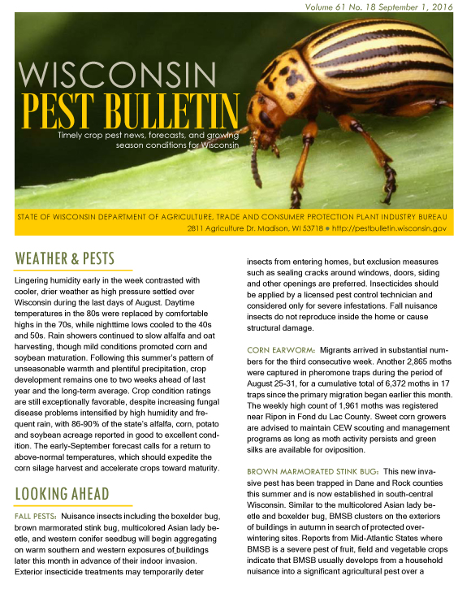
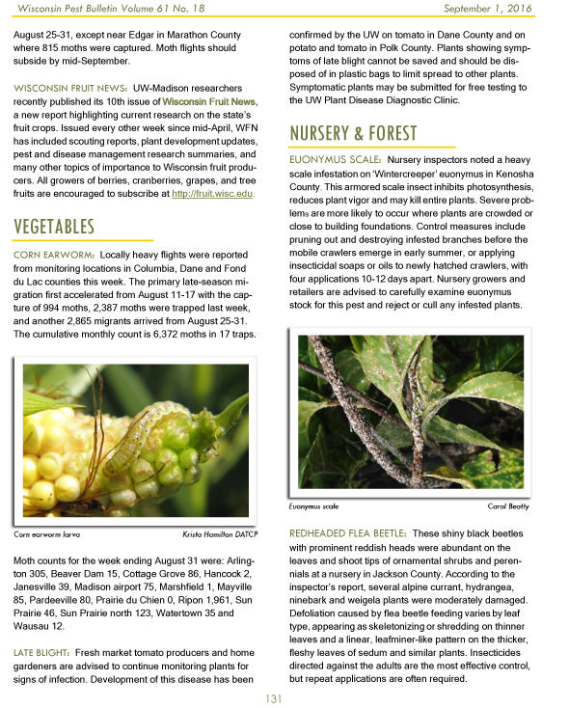
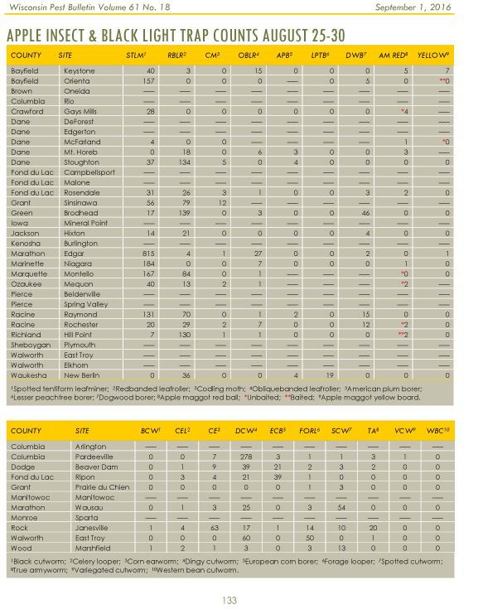
datcp
Notes:
No crossword or comics, but timely information

Slide 26
datcp
ACKNOWLEDGEMENTS
Growers:
Alice's Garden
Badger Organics (Two Good Farms)
Bill Brewer Farm
Bill Hansen Farm
Burr Oak Gardens
Cedar Hill Farm and Greenhouse
Eagle Heights Community Gardens
Farley Center
Firefly Ridge (UWEX Milwaukee Co)
Fondy Farm (Mequon Nature Center)
Forest Hill (UWEX Milwaukee Co)
Full Harvest Farm
Grow to Share
Hudson Hospital Community Garden
Josie Dillon, IPM Institute
Kane St. Community Garden
Kohl Farm (UWEX Milwaukee Co)
Mayo Clinic Garden
Mitchell Air Garden (UWEX MKE Co)
Old Oak Family Farm
Pinehold Garden
Rising Sun Farm & Orchard
Roots & Shoots
Sprouting Acres
Sun Prairie Community Gardens
Sweet Top Farm
The Threshing Table
The Tree Farm
Turnip Rock
White Pine Berry Farm
Whitefeather Organics LLC
Wisconsin Rapids Garden
Colleagues and Survey Staff:
Annie Deutsch, UWEX Door Co. Megan Eames, DATCP
Sam Fieweger, DATCP
Krista Hamilton, DATCP
PJ Liesch, UW-Madison
Anette Phibbs, DATCP
Tracy Schilder, DATCP
Peter Werts, IPM Institute
The taxpayers of the United States, through the 2014 Farm Bill Pest Detection Program!

